Slide 1
Review of UK TNE in the Caribbean

Slide 2
Outline
What we do
How we do it
Developments in UK TNE
Why the review of the Caribbean?
The review process
Key findings
Notes:
Distance learning (DL) is a type of provision that we hadn’t looked at in particular detail through our previous TNE reviews. Given the prevalence of DL in the Caribbean and, in particular, in Trinidad and Tobago it seemed logical to undertake a review in the region.
Trinidad and Tobago was chosen because of the large number of TNE students - according the 2012-13 data was in the top 10 of countries for UK TNE; just fallen outside of top 10 according to latest data, but still significant. One of the few regions in the top 10 that we hadn’t visited.
ACTT suggested that it might be helpful for QAA to provide assurance of the quality of UK higher education delivered in Trinidad

Slide 3
QAA’s role in TNE
QAA is an independent body entrusted with monitoring, and advising on standards and quality in UK higher education wherever delivered
We share a commitment to the internationalisation of UK higher education and to the protection of UK standards
We are fully engaged in European and International Networks for Quality Assurance and Enhancement
We support the governments International Education Strategy for the promotion of UK TNE.
Notes:
Distance learning (DL) is a type of provision that we hadn’t looked at in particular detail through our previous TNE reviews. Given the prevalence of DL in the Caribbean and, in particular, in Trinidad and Tobago it seemed logical to undertake a review in the region.
Trinidad and Tobago was chosen because of the large number of TNE students - according the 2012-13 data was in the top 10 of countries for UK TNE; just fallen outside of top 10 according to latest data, but still significant. One of the few regions in the top 10 that we hadn’t visited.
ACTT suggested that it might be helpful for QAA to provide assurance of the quality of UK higher education delivered in Trinidad

Slide 4
The Quality Assurance of TNE
Review of UK Degree-awarding institutions: Higher Education Review
The UK Quality Code: Chapter B10
Country reviews
Working in partnership with other agencies
System to system programmes
QAA Concerns Scheme
Notes:
Distance learning (DL) is a type of provision that we hadn’t looked at in particular detail through our previous TNE reviews. Given the prevalence of DL in the Caribbean and, in particular, in Trinidad and Tobago it seemed logical to undertake a review in the region.
Trinidad and Tobago was chosen because of the large number of TNE students - according the 2012-13 data was in the top 10 of countries for UK TNE; just fallen outside of top 10 according to latest data, but still significant. One of the few regions in the top 10 that we hadn’t visited.
ACTT suggested that it might be helpful for QAA to provide assurance of the quality of UK higher education delivered in Trinidad

Slide 5
A snapshot of UK TNE
Students studying for UK awards in over 200 different countries
638,850 students (2013-14):
+7% on the previous year
131 (78%) UK higher education institutions now involved in some form of TNE.
Top 10 countries for UK TNE (2012-13, student numbers)
Malaysia 77,440
China 50,235
Singapore 50,070
Pakistan 43,430
v) Nigeria 28,455
Hong Kong 28,395
Ghana 17,130
viii) Oman 15,675
UAE 15,270
x) Egypt 14,715
Source of data: HESA (2013-14)
Notes:
This is a snapshot of UK TNE today
HESA data for 2012- 2013:
598,925 TNE students studying with UK providers:
87% of these (521,685) outside the European Union
78% of UK higher education institutions now have some form of TNE, across more than 200 countries
This table shows the top ten countries (by student number) for UK TNE:
Malaysia is top of the list (68,020 students)

Slide 6
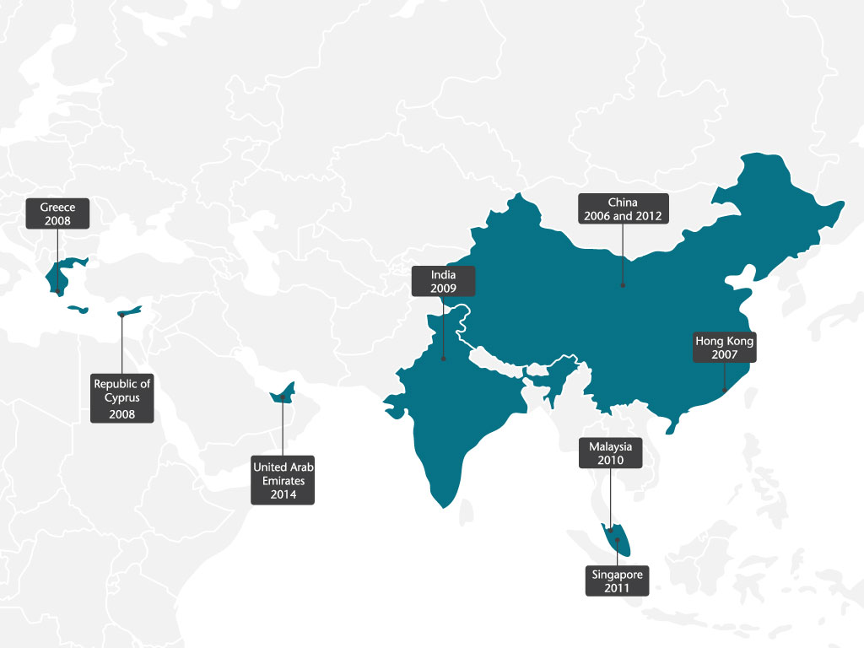
UK TNE review activity
Notes:
QAA has been conducting reviews of TNE for a number of years
This is currently done on a annual, country-by-country basis
[Although this approach may change in future, following the recent UK consultation on TNE]
This map shows where QAA has undertaken TNE reviews, including:
China (twice)
Hong Kong
Cyprus
India
Greece
Malaysia
United Arab Emirates
Singapore

Slide 7
Why the Caribbean?
Distance learning
Over 12,000 students registered on UK University awards in Trinidad and Tobago (HESA 2013-14)
Accreditation Council of Trinidad and Tobago (ACTT)
Notes:
Distance learning (DL) is a type of provision that we hadn’t looked at in particular detail through our previous TNE reviews. Given the prevalence of DL in the Caribbean and, in particular, in Trinidad and Tobago it seemed logical to undertake a review in the region.
Trinidad and Tobago was chosen because of the large number of TNE students - according the 2012-13 data was in the top 10 of countries for UK TNE; just fallen outside of top 10 according to latest data, but still significant. One of the few regions in the top 10 that we hadn’t visited.
ACTT suggested that it might be helpful for QAA to provide assurance of the quality of UK higher education delivered in Trinidad

Slide 8
Review process
Similar methodology to previous QAA reviews
Desk-based analysis
UK visits to selected institutions
Overseas visit to Trinidad
Published findings (18 March 2015)
Peer review
Close working relationship with the Accreditation Council of Trinidad and Tobago
Notes:
Similar methodology to previous TNE reviews
Desk-based analysis – selected 10 UK universities for inclusion in the review based on size of provision. Asked each institution to provide a brief commentary on their TNE arrangements, along with supporting evidence
UK visits to selected institutions – to explore any preliminary lines of enquiry directed towards the UK institution
Overseas visit to Trinidad – to meet with staff and students at a sample of local providers working in partnership with the UK institutions, providing an opportunity to follow up on identified issues and also to look more directly at the student experience.
Publish findings (18 March 2015) Available through QAA website and comprise: six reports on individual partnerships, four case studies on institutions with large global provision, and an overview report summarising key trends arising from the review as a whole
Peer review – 3 reviewers occupying senior positions in UK universities; coordinated by two members of QAA staff
Close working relationship with the Accreditation Council of Trinidad and Tobago – staff from ACTT joined QAA in a number of visits as observers. We are also thankful to the operational support provided

Slide 9
Notable features
Government funding of foreign tertiary education
Most common type of provision is some form of locally supported learning
Over 80% studying part-time
Notes:
Government funding of tertiary education (Government Assistance for Tuition Expenses)
Audience will be aware of this but perhaps worth acknowledging because it was a significant factor in the successful recruitment of UK TNE programmes. One of the recommendations that came out of the review was for UK institutions to ensure they are able to continue to demonstrate local demand and relevance for their programmes, which we understand will become increasingly more important as Trinidad identifies priorities for developing the higher education sector.
Most common type of provision is some form of locally supported learning – either supported distance learning or where a local partner delivers a programme designed by the UK University.
Over 80% studying part-time - To a certain degree representative of distance learning. Mature learners whose motivation is career advancement.

Slide 10
Key findings
Student support
Top-up programmes
Staff development
PSRB engagement
Notes:
Student support. We found that in general students are well supported in achieving their qualification. This support is provided by staff at local partners in Trinidad as well as by staff in the UK, which in the case of supported distance learning also includes online support through virtual classrooms.
Top-ups (Might need to explain top-up)
Although not accounting for large number of students, four UK institutions delivered Level 6 top-ups. In all cases these were to ‘top-up’ recognised qualifications eg HNCs and HNDs rather than to top-up a course designed by a partner institution. Most students accustomed to the British style of delivery and therefore found the transition to L6 smooth. Highlights the synergies between UK and Trinidadian higher education systems.
Staff development
There is good evidence of investment in staff development by both UK institutions and local institutions. This ranges from visits by UK staff to undertake bespoke staff development activities to opportunities to undertake formal qualifications through the UK institutions. These opportunities were extended to both academic and support staff.
PSRB engagement
There is a very considerable interest in achieving accreditation and/or recognition of awards by relevant professional bodies. Areas of PSRB involvement include computing, accountancy, law, built environment and subjects allied to health but there are more.
There is a good deal of professional body involvement in curriculum design. Indeed, without ACCA support the OBU BSc in Applied Accounting would be unviable in its present form. Worth noting that the ACCA also added richness to OBU’s presence in the Caribbean through its links with national accountancy bodies in 5 of the islands. Joint Examination Schemes in 16 countries.
Providers go to considerable lengths to achieve robust relationships with in-country PSRBs, economic development agencies and sometimes governmental agencies.
Important for specialised programme accreditation by ACTT
Students were aware professional accreditation and how relevant it is in their local context and for their future professional mobility.

Slide 11
Key findings
Localisation of a global curriculum
Changing approaches to managing TNE
Challenges in data management
Student employability
Similarities between the British and Trinidadian education systems
Notes:
Localisation of a global curriculum
Some localization of the curriculum occurs in vocational subjects like land law, health and social care and accountancy where national or regional jurisdictions and accounting conventions differ from those of the relevant professional bodies in the UK. This localisation also occurs in humanities disciplines such as media studies which forge links with in-country employers.
In such cases whole modules may be modified to suit local conditions. In other cases modules are designed to provide students with some opportunities to use local examples in their assessed work. A typical example would be in major projects at UG, PG and doctoral level.
This contextualisation of the curriculum is important as it provides a local flavour to generic, global provision – including opportunities for organizing local activities and work experience opportunities.
Changing approaches to managing TNE
A trend that came through this review is the way in which UK institutions’ processes for collaborative provision have evolved. A number of institutions have integrated TNE within the management of their core provision – with the view to achieve better integration and oversight, reducing the historic separateness of TNE. This enables UK universities to use the feedback received by partner institutions, like those in Trinidad, to inform the development and review of their programmes.
Data management - retention, progression and achievement
While flexibility of delivery was seen as a positive by both institutions and students it did present challenges in collecting and analysing data eg achievement, progression and retention. Further complicated by students taking breaks between studies etc. Given that students the review team met with were generally quite positive about their experience could be benefits in making this information available to prospective students.
We are aware that this is an area that ACTT is also working on and is currently supporting institutions in Trinidad to enhance local systems for data collection and monitoring.
Student employability
Again an area where perhaps better data could be collected, although local partners were conducting their own graduate destination surveys.
Part-time students undertaking postgraduate qualifications for career progression as opposed to gaining their first job.
Similarities between the British and Trinidadian education systems
There are lots of similarities between the English-speaking Caribbean and the UK, and this has made the UK an obvious choice for TNE.
No language barrier.
Secondary education system in the Caribbean is based on the English A-levels and therefore transition to UK higher education is quite smooth.
UK TNE seems to have has played an important part in helping to increase academic capacity.

Slide 12
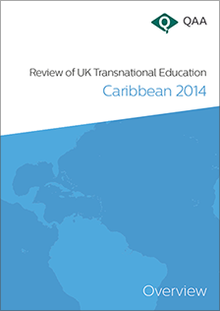
Reports are available to view at:
http://www.qaa.ac.uk/en/ReviewsAndReports/Pages/TNE-Caribbean-2014.aspx
Notes:
Localisation of a global curriculum
In all cases Caribbean TNE is effectively a regional instantiation of a global model. Case study institutions with many thousands of distance learning students globalize their programmes of study in the same manner throughout the world.
Some localization of the curriculum occurs in vocational subjects like land law, health and social care and accountancy where national or regional jurisdictions and accounting conventions differ from those of the relevant professional bodies in the UK. This localisation also occurs in humanities disciplines such as media studies which forge links with in-country employers.
In such cases whole modules may be modified to suit local conditions. In other cases modules are designed to provide students with some opportunities to use local examples in their assessed work. A typical example would be in major projects at UG, PG and doctoral level.
Providers working with in-country support centres state that the latter are able to provide a local flavour to generic, global provision as well as organizing local activities and work experience opportunities.
Changing approaches to managing TNE
A trend that came through this review is the way in which UK institutions’ processes for collaborative provision have evolved. A number of institutions have integrated TNE within the management of their core provision – with the view to achieve better integration and oversight, reducing the historic separateness of TNE. This has enabled UK universities to use the feedback received by partner institutions, like those in Trinidad, to inform the development and review of their programmes.
Student employability
Again an area where perhaps better data could be collected, although local partners were conducting their own graduate destination surveys.
Part-time students undertaking qualification for career progression as opposed to gaining their first job.
Similarities between the British and Trinidadian education systems
There are lots of similarities between the English-speaking Caribbean and the UK, and this has made the UK an obvious choice for TNE.
No language barrier.
Secondary education system in the Caribbean is based on the English A-levels and therefore transition to UK higher education is quite smooth.
UK TNE seems to have has played an important part in helping to increase academic capacity.

Slide 13
Dr Stephen Jackson
Associate Director International
Quality Assurance Agency for Higher Education, UK
^{@QAAtweets}
^{qaa.ac.uk}
Registered charity numbers 1062746 and SC037786
Notes:
Thank you

