Slide 1
Competency-Based Education: Promises and Challenges
ACTT Conference
April 15, 2015

Slide 2
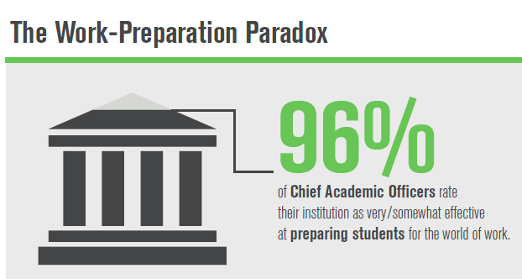
We are encouraged…
Sources: Lumina Foundation/Gallup Poll 2013 and
The 2013 Inside Higher Ed Survey of College & University Chief Academic Officers report

Slide 3
Public opinion is not encouraging
Sources:
Lumina Foundation/Gallup Poll 2013
The 2013 Inside Higher Ed Survey of College & University Chief Academic Officers report

Slide 4
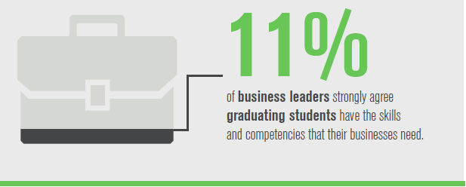
Feeling the heat now?
Sources:
Lumina Foundation/Gallup Poll 2013
The 2013 Inside Higher Ed Survey of College & University Chief Academic Officers report
Notes:
The Work Preparation Paradox is stunning. There seems to be a real lack of confidence in U.S. higher education or is it a lack of understanding?

Slide 5
What is all of the fuss about?
Concern about accountability in higher education
Employers’ changing work force needs
Push for degree completion
Innovation and technology
Globalization, interdependent world
What does a degree mean?
Notes:
We know the U.S. goal is for 60% (or more) of the U.S. population to hold a degree or postsecondary credential by 2025 – Embedded in this goal is the important priority of closing the achievement gap – with a diverse work force, we need to increase postsecondary credentials for historically under-represented groups. Emphasize the new technologies, including the prominence of free content (MOOCs, education outside of the academy) and a more connected citizenry, policy makers are asking, “Can we do this another way? Increase access, provide more personalized and meaningful learning, AND cut costs?

Slide 6
Nearly all employers surveyed (93%) agree, “a [job] candidate’s demonstrated capacity to think critically, communicate clearly, and solve complex problems, is more important than their undergraduate major.”
Source: It Takes More Than a Major: Employer Priorities for College Learning and Student Success. 2013. Washington DC. Association of American Colleges and Universities and Hart Research Associates.

Slide 7
What Is Entry Level?
“Instead of memorizing 15 or 20 steps in a calculation process, fund accountants at the [State Street] bank now must be able to identify anomalies, help resolve software glitches and figure out which other teams they should work with. In some cases, they must also call clients directly, putting a new premium on people skills.”
Source: Wall Street Journal, August 6, 2014
“Where Did All the Entry-Level Jobs Go?”
Notes:
State Street Bank’s HR team, with input from front-line managers, is supplementing traditional job descriptions with more detailed "role charters" for entry-level jobs, emphasizing more abstract and sophisticated skills such as collaboration and problem-solving rather than basic functions such as report preparation.

Slide 8
Why Competencies?
Quality
Clearly define what graduates are expected to know and do
Communicate these expectations to students, employers and other stakeholders. (Provides transparency)
Notes:
Note: Some have said the push to find a lower cost, but high quality degree, is why CBE is emerging. Others are saying, it’s emerging because the technology can now support it, and there are built-in efficiencies when the learner can leverage existing knowledge.

Slide 9
What is a Competency?
Competency =
Knowledge + Skill

Slide 10
Defining Competencies
Beyond learning outcomes
Not just skills and knowledge, but also the ability to apply learning in different situations
Specific in terms of levels of performance
Objectively measured
Holistic

Slide 11
Competency Example
Competency: Critical Thinking
Subcompetencies:
Define the problem/issue
Evaluate evidence or data on the topic
Consider context or assumptions in the evidence
Propose an interpretation or hypothesis
Identify alternatives, conclusions, or implications

Slide 12
Competency Exercise
Competency: Written Communication
Subcompetencies
?
?
?
?
?
Notes:
Answers:
1- Define the purpose of the writing
2- Select relevant and compelling content
3- Comply with norms or conventions
4- Select credible sources and evidence
5- Use correct syntax and mechanics

Slide 13
Changing the Formula
X
Time
Fixed
Learning
Variable
Notes:
Ask any educator what is most important and they will likely say LEARNING. But, the way we measure learning is changing – quickly. Seat time and credit hours are increasingly coming into question. Learning should be FIXED and time VARIABLE, not the opposite. When this principle is adhered to, we call it Direct Assessment CBE. SO – Explain HYBRID and DIRECT ASSESSMENT models using this diagram.
“Competency-based education flips the relationship and says let time be variable, but make learning well-defined, fixed, and non-negotiable.”
-- Paul LeBlanc, President, Southern New Hampshire University

Slide 14
PLA and CBE Converge
Prior Learning Assessment Refresher:
PLA is the process for recognizing college-level learning acquired outside of the traditional college classroom .
Students must demonstrate that they have achieved the same learning outcomes and/or competencies as a student who passes the course.
Notes:
Explain the various kinds of PLA – Standardized tests such as CLEP, Uexcels, DSSTs; ACE and NCCRS-evaluated training/courses for credit recommendations; portfolio and performance assessments.

Slide 15
College-Level Learning
College level learning typically refers to learning that is:
other than general knowledge;
combines practical and theoretical knowledge in ways appropriate to a given field;
of a certain level of breadth and/or depth and complexity;
is represented in existing college curricula
Notes:
Chari

Slide 16
Adult Learners and PLA
Application or Demonstration
Theory
Experiential learning, on-the- job learning, employer training, free courses, PD
May have minimal or no understanding of the theories behind what they do.
Notes:
Take time to talk about adult learners, how they learn experientially and how they peg learning to their experiences. Also talk about “adult” attributes are shared by many “traditional-aged college students” today because college is not their primary focus – they are likely working, may have dependents, etc. Refer to the workbook “refresher” on adult learners.

Slide 17
PLA /CBE are Learner-Centric
Successful PLA and CBE students earn credit for what they know and can do, significantly saving them time to a degree or credential.

Slide 18
Teaching to Competence
A primary focus on competence rather than content shifts the role of faculty to serve more as facilitator of learning rather than content expert

Slide 19
Many Faculty Roles
Determining the learning outcomes (competencies, skills, knowledge sets) that students must achieve in order to earn the credential (micro, certificate, or degree).
Determining how best to demonstrate the learning
Designing the assessments/rubrics
Ensuring link with K12, employers, receiving colleges

Slide 20
Many Faculty Roles
Locating the learning resources, materials, texts, exercises, etc.
Mentoring, coaching students
Determining how competencies fit throughout the curriculum, levels of competencies (proficiency to mastery), overlap/reinforcement of competencies
Teaching/Assessing

Slide 21
Principles of Good Assessment
Must be reliable, valid, fair, and authentic
Must provide useful information about student learning
Must provide information that will improve the teaching and learning experience

Slide 22
Competency-Based Assessment
What are we assessing? Defined competency with appropriately designed and validated assessment/rubric
How will students demonstrate the learning or mastery of a competency?
Do we use a binary approach or add levels of proficiency?
Who will assess it?
How do we help the student try again?

Slide 23
Competency-Based Assessment
Direct Assessment Model
Such as College for America
Totally divorced from the credit hour and seat time.
Competencies established first, then built out how they could be attained
Hybrid Models
Most popular
Competency units = credit hours
Still have course organization

Slide 24
Competency-Based Assessments
Formative and summative assessments
How can the student check his/her progress? Practice quiz? Low stakes assignments?
Performance-based assessments, narratives/papers, simulations, projects, videos, portfolios, capstones
Multiple Choice or Standardized Tests
How will the assessments be administered?
Are we seeking competency or mastery?
Disaggregated faculty role?

Slide 25
Academic Consideration
Where to start? A new course/micro credential (incremental), program, certificate, degree or institutional shift? PLA? Model: Hybrid or D.A.
Faculty roles?
Faculty governance and organization?
Working with community, employers?
Ensuring we fulfill our mission
Transfer and articulation

Slide 26
Administrative Considerations
Infrastructure concerns: SIS
How will we produce a transcript?
Business model: Subscription or $ per credit hour?
Permissions: Accrediting Body
Resources for planning: such as providing release time for faculty, funding, etc.

Slide 27
Questions????

