Slide 1
ACTT ACCREDITATION COUNCIL OF TRINIDAD & TOBAGO
SECOND ANNUAL INTERNATIONAL CONFERENCE
APRIL, 2015©
HYATT – PORT OF SPAIN, TRINIDAD & TOBAGO

Slide 2
Theme: THINKING GLOBAL – ACTING LOCAL: “The Changing Realities of Higher Education”
MEETING LABOUR MARKET DEMANDS:
‘INCREASING RELEVANCE IN EDUCATION AND TRAINING’
Title of Paper: Enhancing Experiential and Prior Learning practices to meet Workplace Learning Competencies
Mervyn Extavour – Dir. ACTT - Presenter

Slide 3
APPROACH
LOOKING AT ‘INDEPENDENT LEARNING’ AS AN ACADEMIC LEARNING MEASURE
IMPACT OF TECHNOLOGY ON MODERN & GLOBAL LEARNING STRATEGIES
LABOUR MARKET SURVEY OF ‘DEMAND-LED’ EMPLOYMENT – IMPLICATIONS
CONSTRUCTS OF ‘INDEPENDENT LEARNING’ – ‘PRIOR LEARNING’ AND ‘EXPERIENTIAL LEARNING’, ETC. AS ASSESSMENT STRATEGIES FOR DEMAND-LED EMPLOYMENT….

Slide 4
LOOKING AT ‘INDEPENDENT LEARNING’ AS AN ACADEMIC LEARNING MEASURE
We have an alternative for today’s society…. We can reclaim learning

Slide 5
The Quest for ‘Independent Learning’ To aid Academic Evaluation
“Independent Learning and Training facilities as a mechanism for:
Vocational Instruction to meet Academic Mobility and global trends”
Finding that balance among e-learning devices.
Coping with the demand -led workplace environment
Acknowledging innovation & creativity

Slide 6
Stephen Downes (2014) http://clt.lse.ac.uk/events/NetworkEDGE/networkEDGE-seminar-series-01.php Kreijns, Kirschner, and Jochems (2002) Ilona Buchem, Gemma Tur Ferrer, Tobias Hölterhof, Journal of Literacy and Technology, Jun 03, 2014 Ben Werdmuller, Benwerd, Jun 03, 2014 Audrey Watters, Hack Education, May 28, 2014 John Hannon, Matthew Riddle, Thomas Ryberg, (2014) Robert Schuwer, Rob Kusters, (2014) www. Learningadming.com (2014) Deci (1996) (Deci & Flaske, 1996, p. 89). Zimmerman (2000) Andrade and Bunker (2009) Chau & Cheng (2009) (Foti & Ring, (2008); Meeus, Van Petegem & Engels, (2009)…” . (Piaget, 1971); (Abrami, et al., (2008) (Moskaliuk, Kimmerle & Cress, 2009); (Richardson, 2009; Yang, 2009); Herrington et al 2009;’ Little, 2009; Stoicovy & Sanchez, 2007). “RESEARCH THEORISTS ON IMPACT OF TECHNOLOGY ON LEARNING”

Slide 7
OWNERSHIP OF MATERIAL
“…Recent literature on e-portfolios practice validates e-portfolios as a platform which allows learners to collect, organize and present digital evidence in a variety of media types over time, for different purposes and audiences (Hartnell-Young, et al.,2007) Joyes, Gray & Hartnell-Young, 2010…” (Chau & Cheng, 2009).

Slide 8
TECHNOLOGY CAN BE CHALLENGING BUT REWARDING
“We can reclaim the Web and more broadly ed-tech for teaching and learning. But we must reclaim control of the data, content, and knowledge we create.”

Slide 9
CRITICAL ELEMENTS OF INDEPENDENT LEARNERS
Development by the student:
RESEARCH – DATA MANAGEMENT –PORTFOLIO PRODUCTION
Demonstration by the student:
PRESENTATION FOR FEEDBACK
REVIEW AND RECAPTURE ACCURACY
OWNERSHIP & ACKNOWLEDGEMENT OF SUCCESS
Self-reflection and internalization

Slide 10
LABOUR MARKET SURVEY OF ‘DEMAND-LED’ EMPLOYMENT: – “IMPLICATIONS”

Slide 11
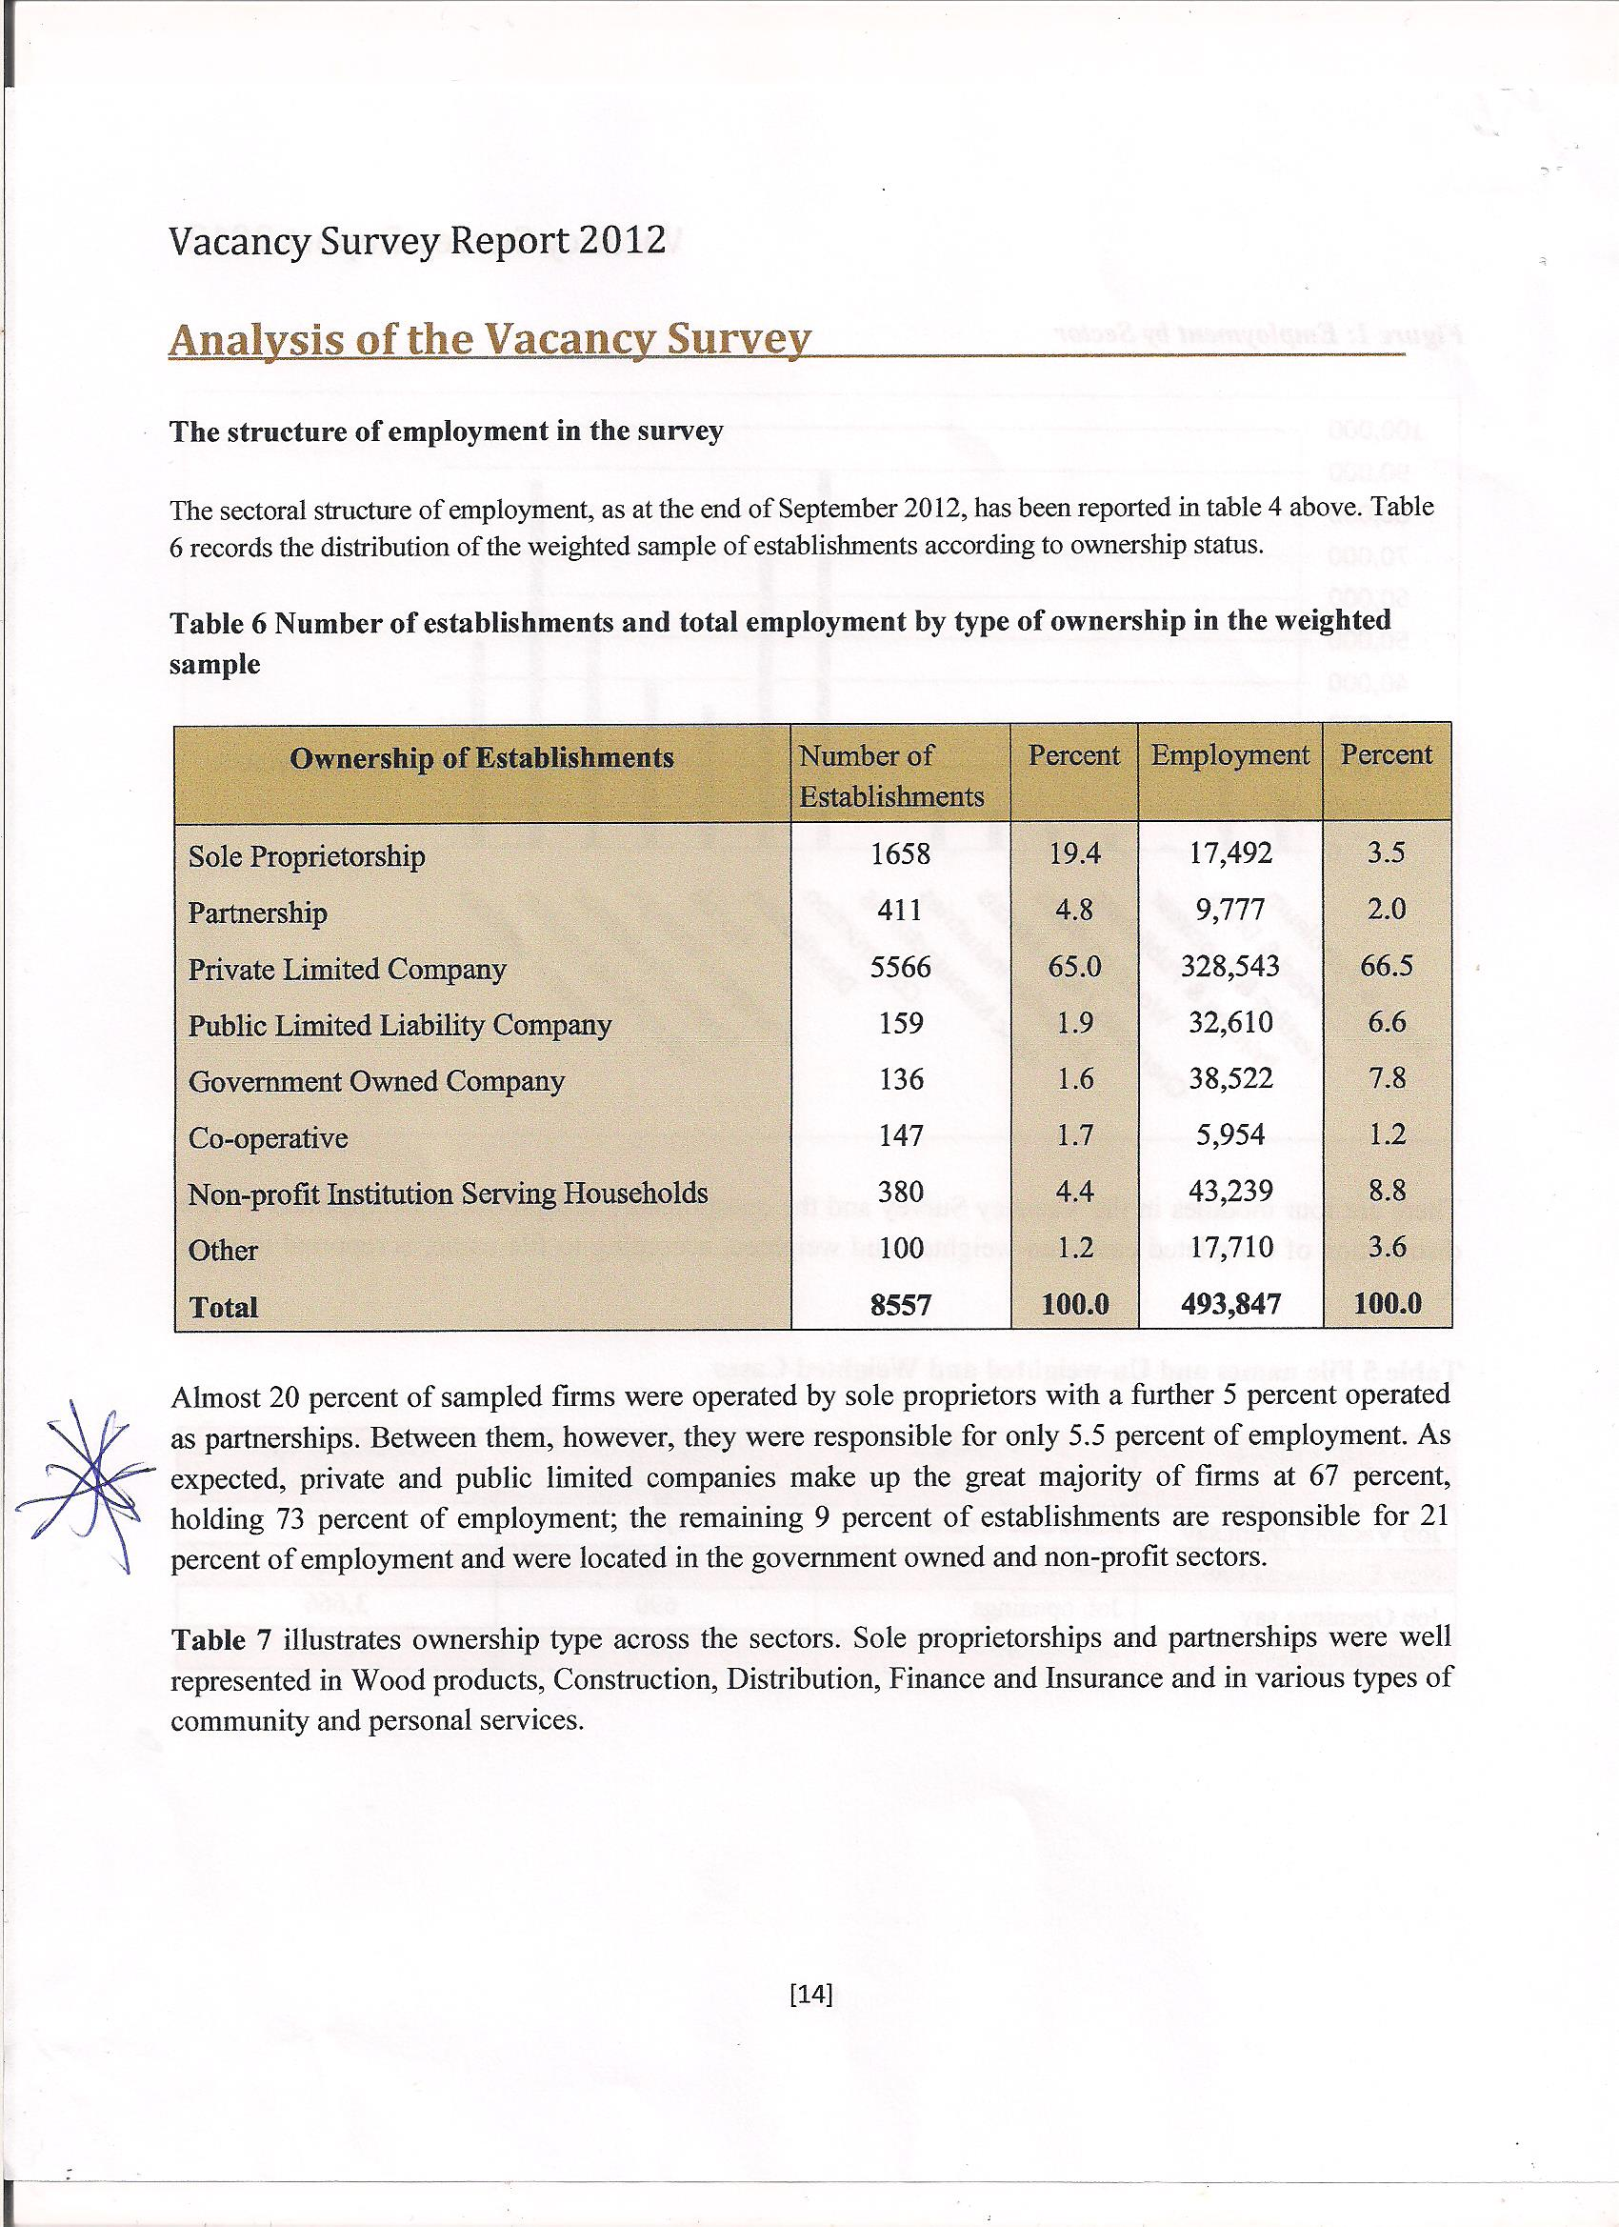

Slide 12
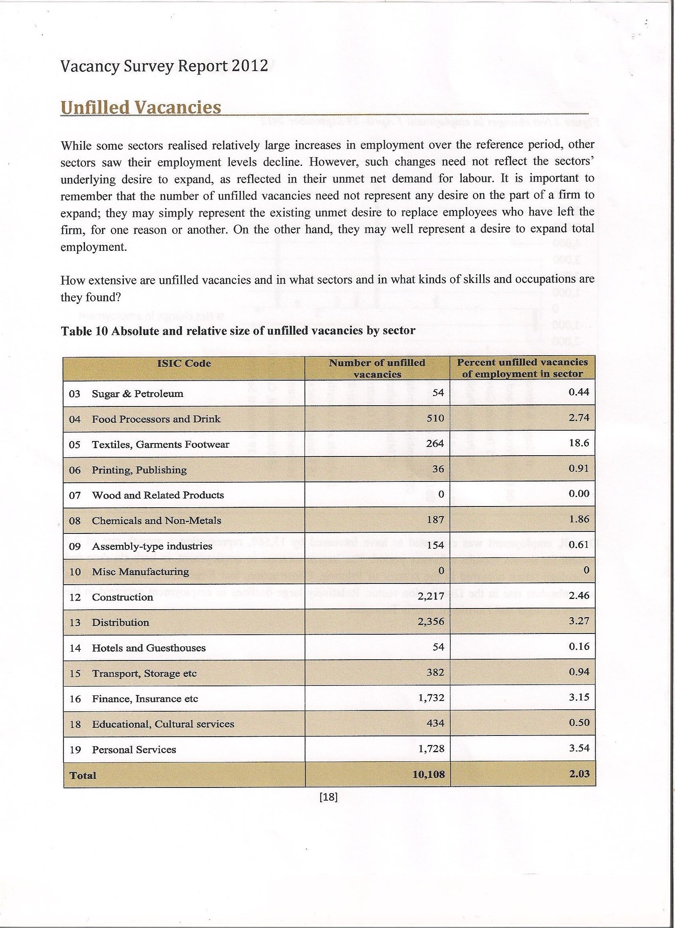

Slide 13
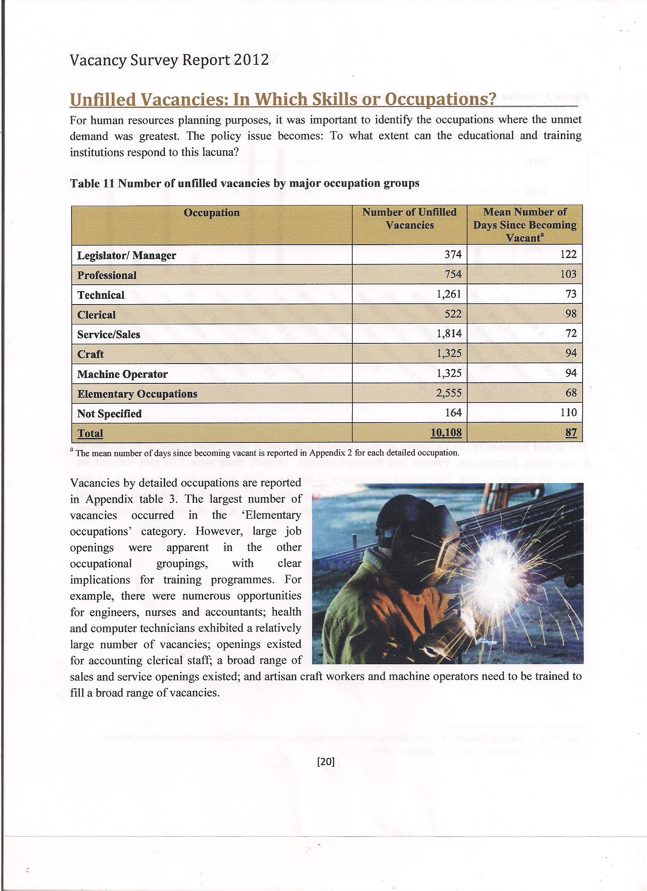

Slide 14
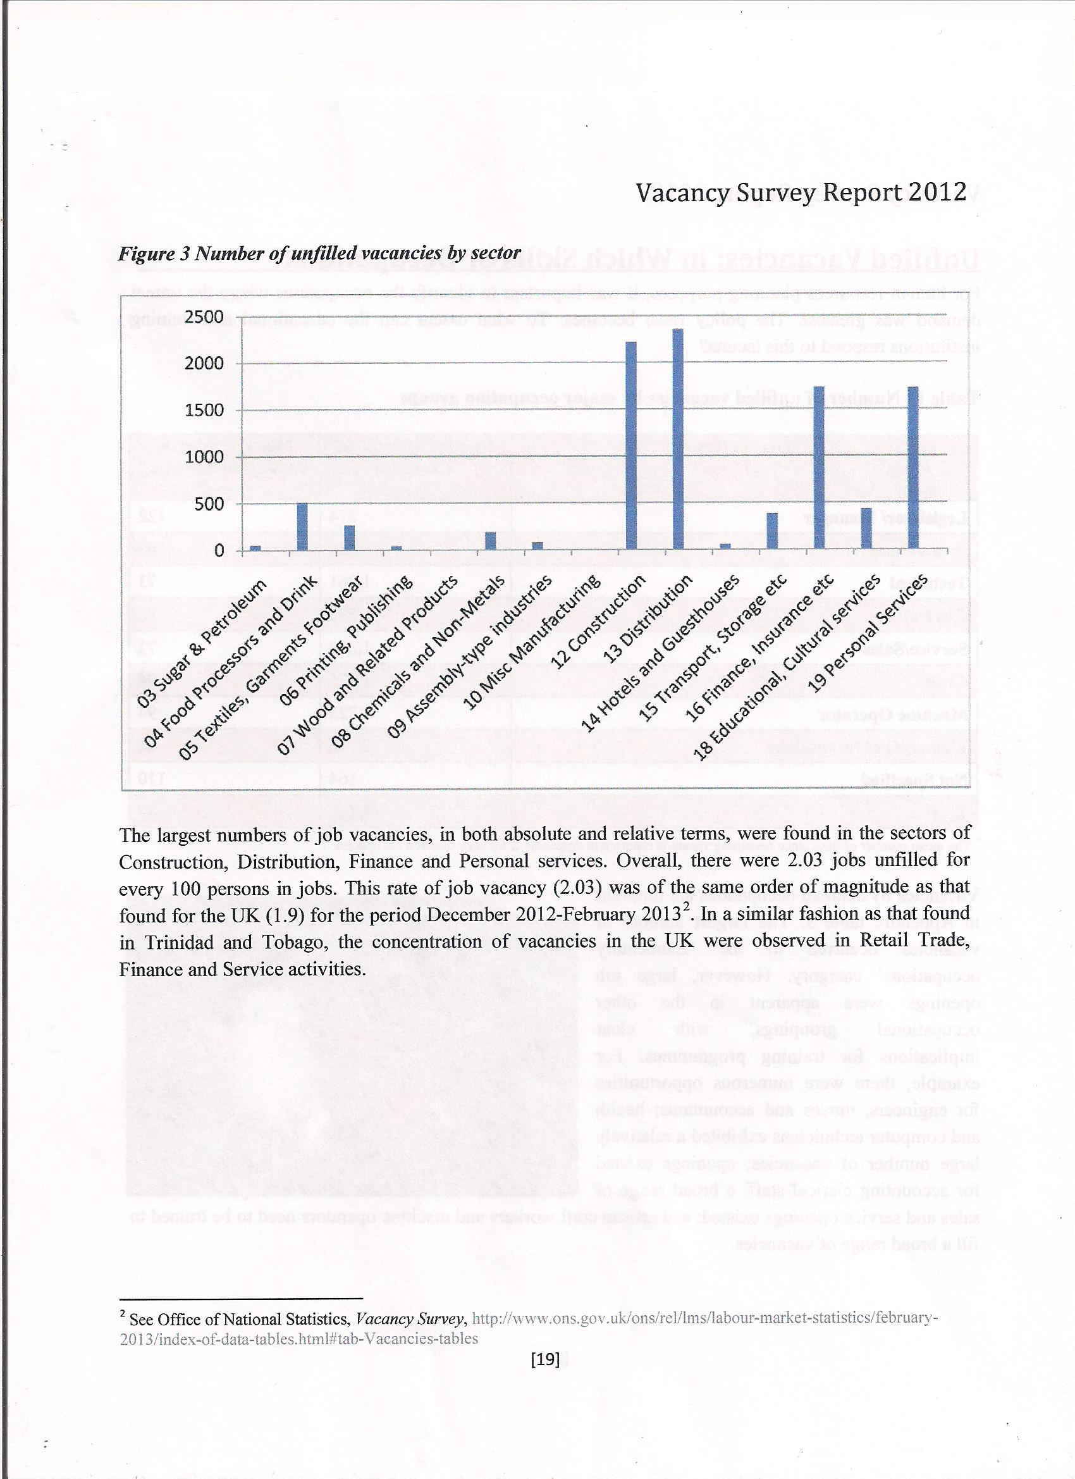

Slide 15
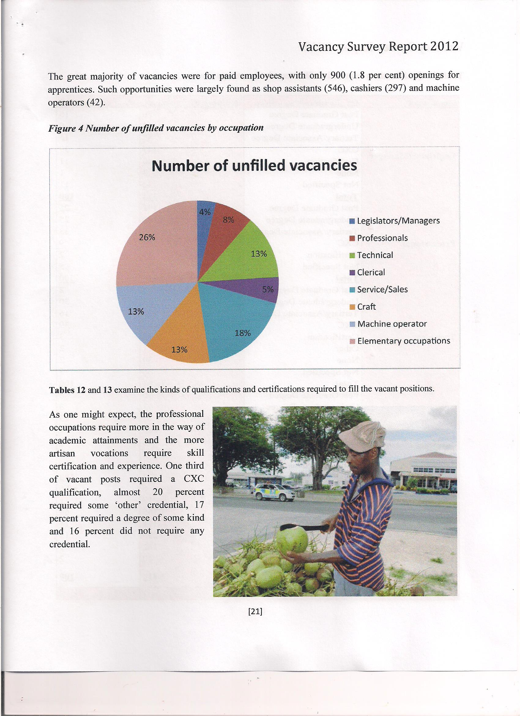

Slide 16
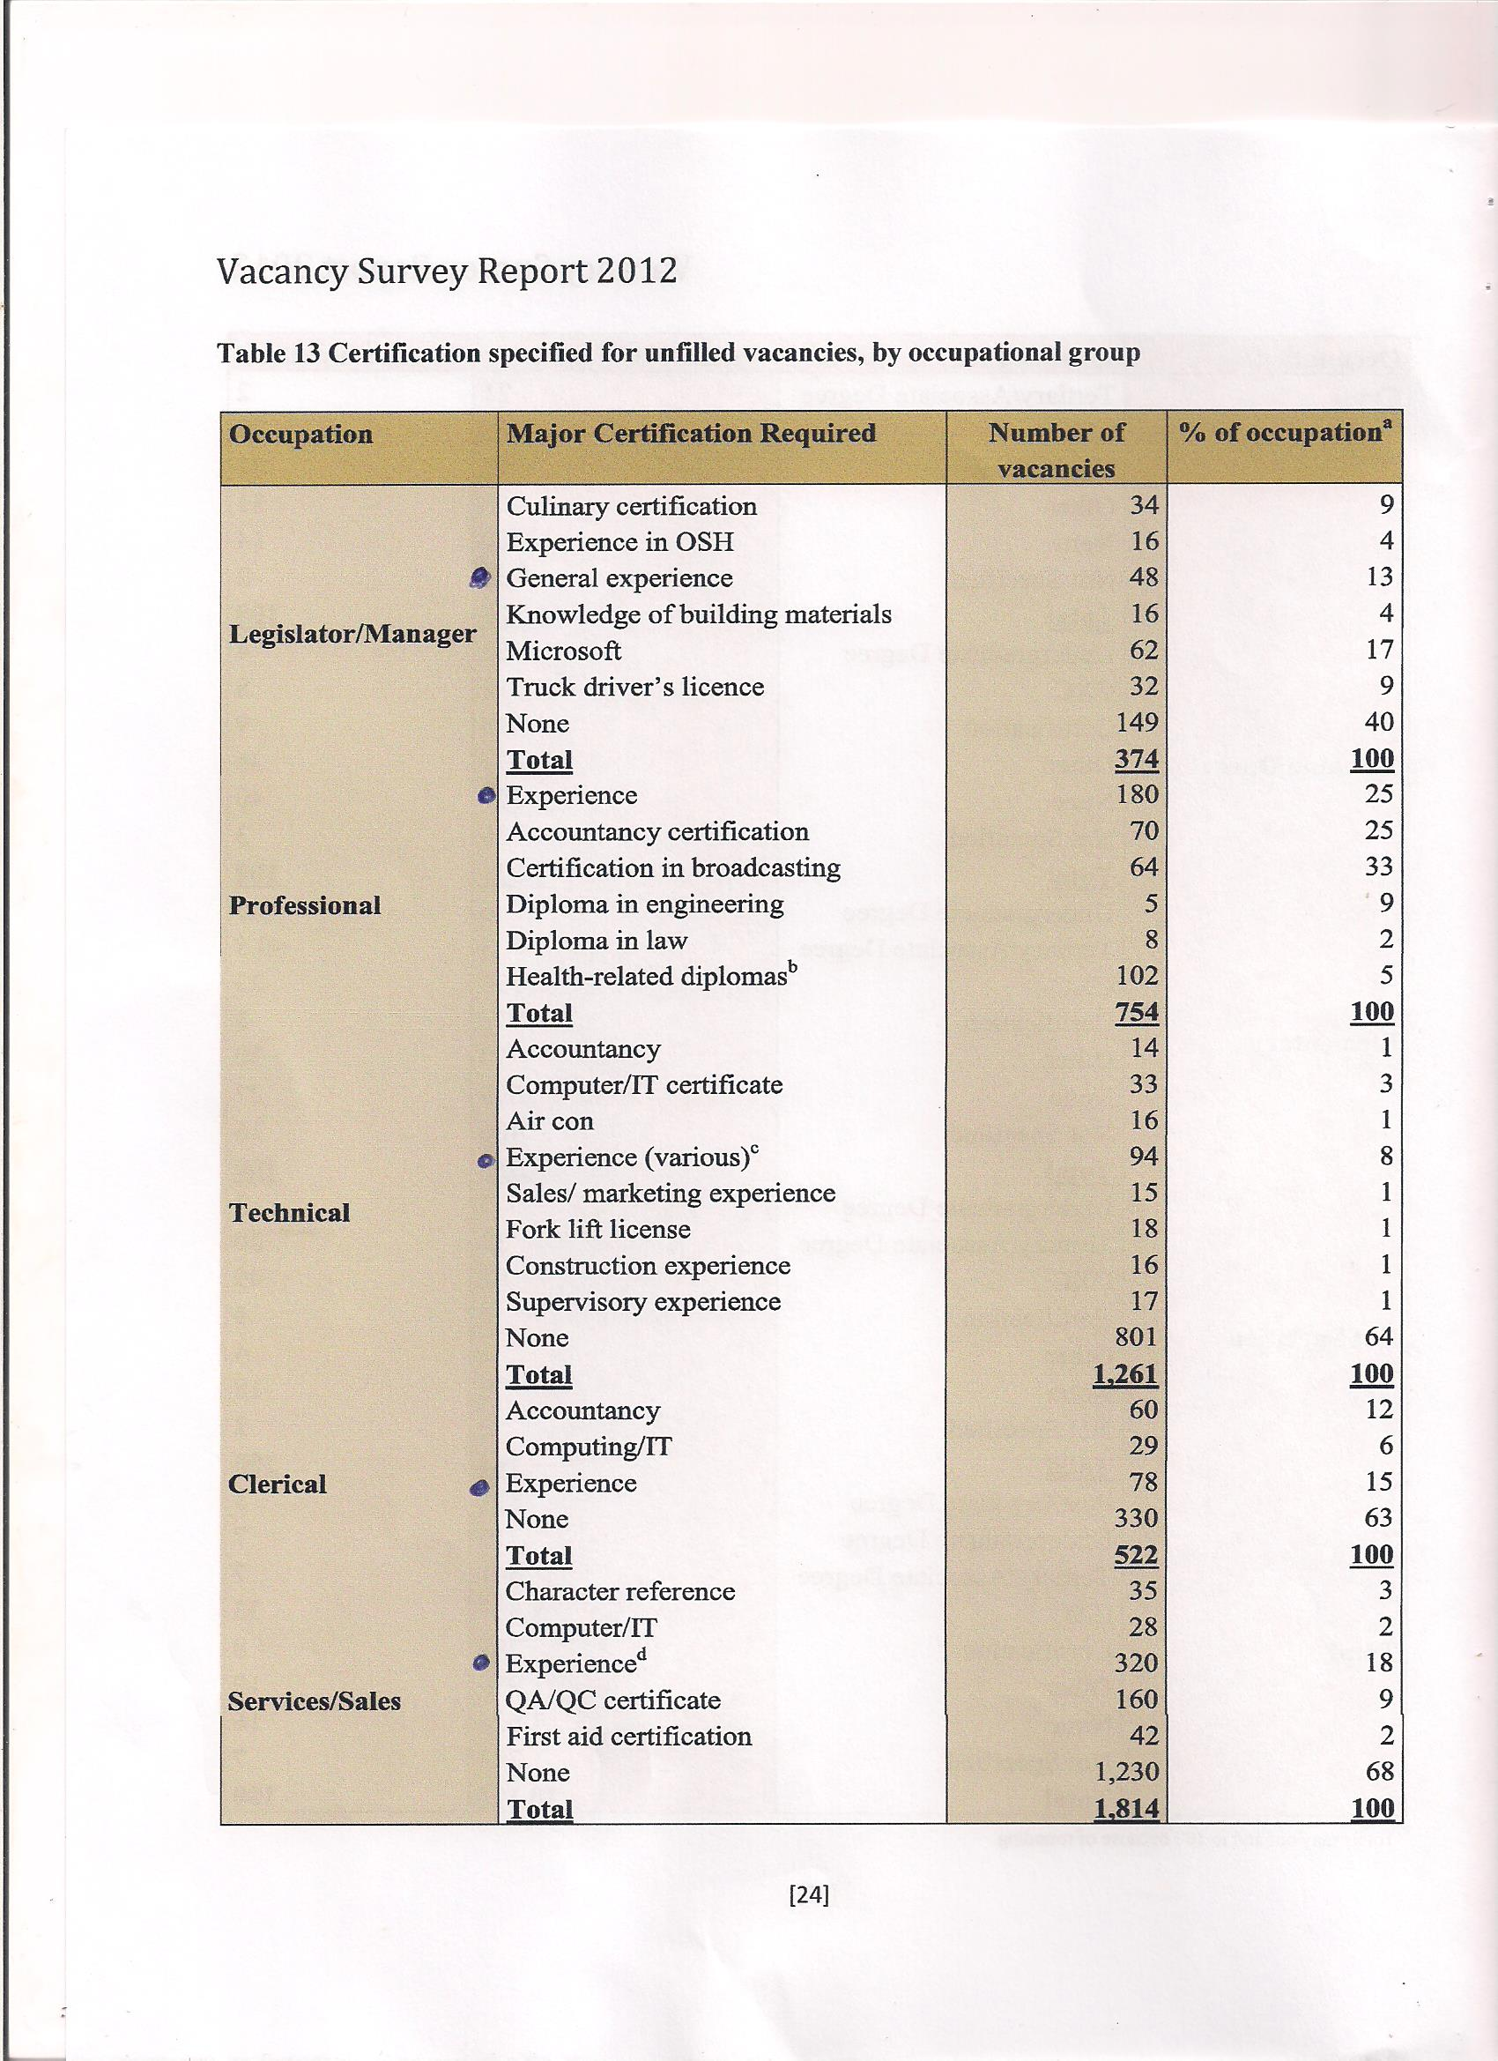

Slide 17
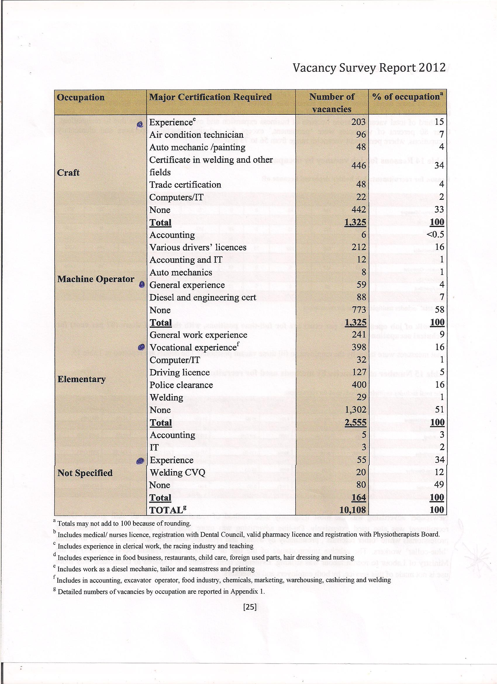

Slide 18
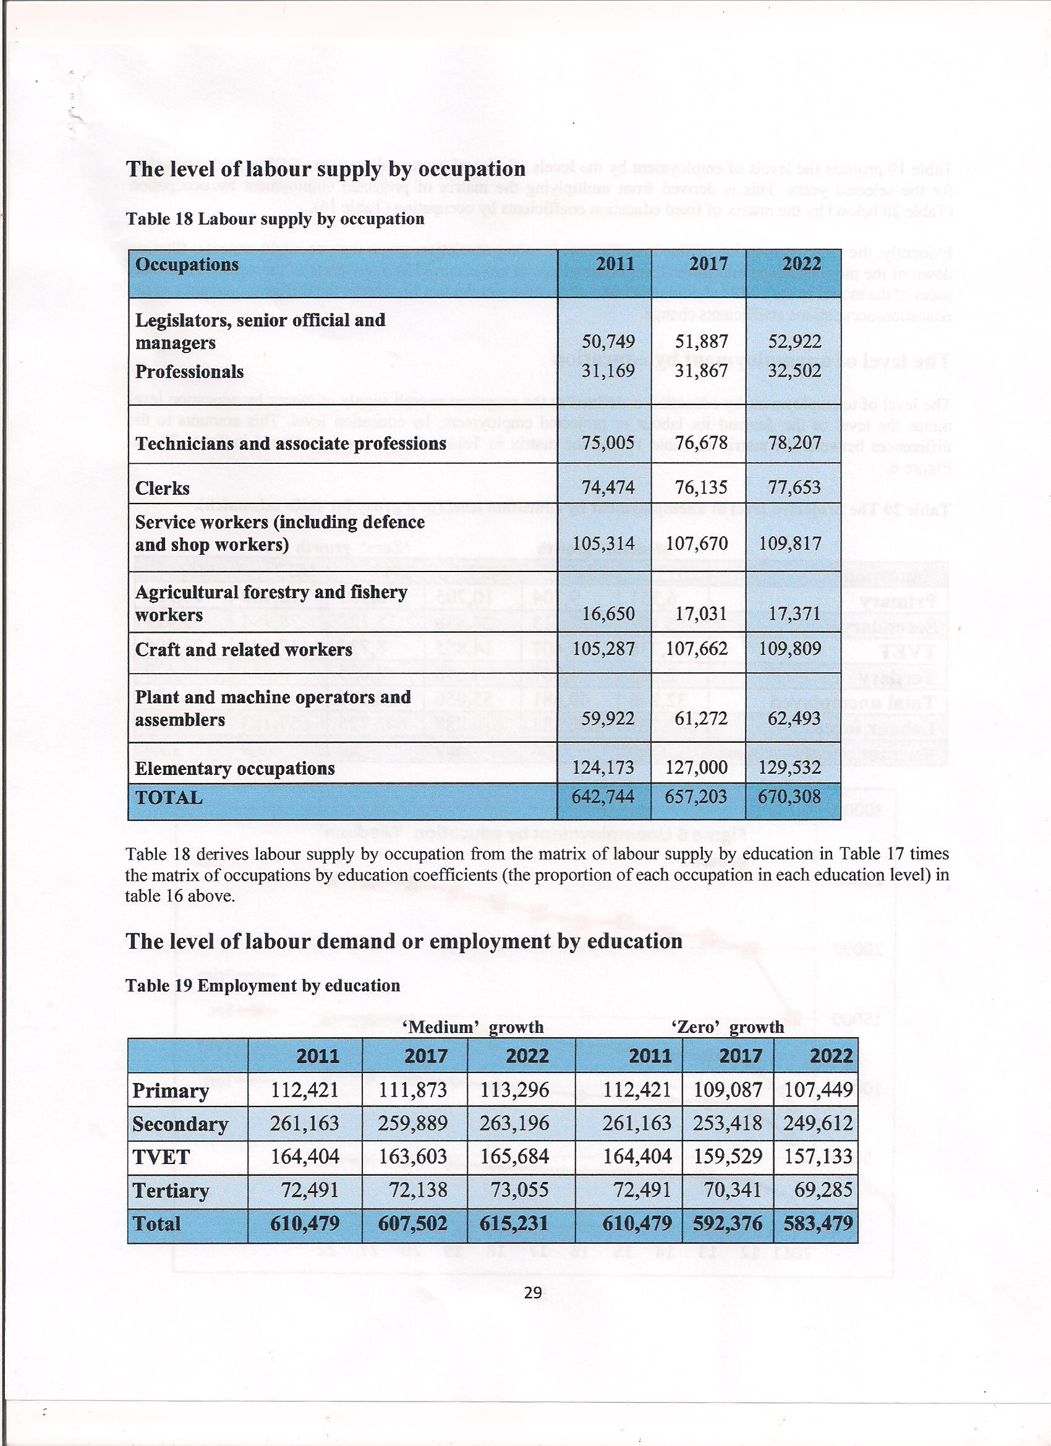

Slide 19
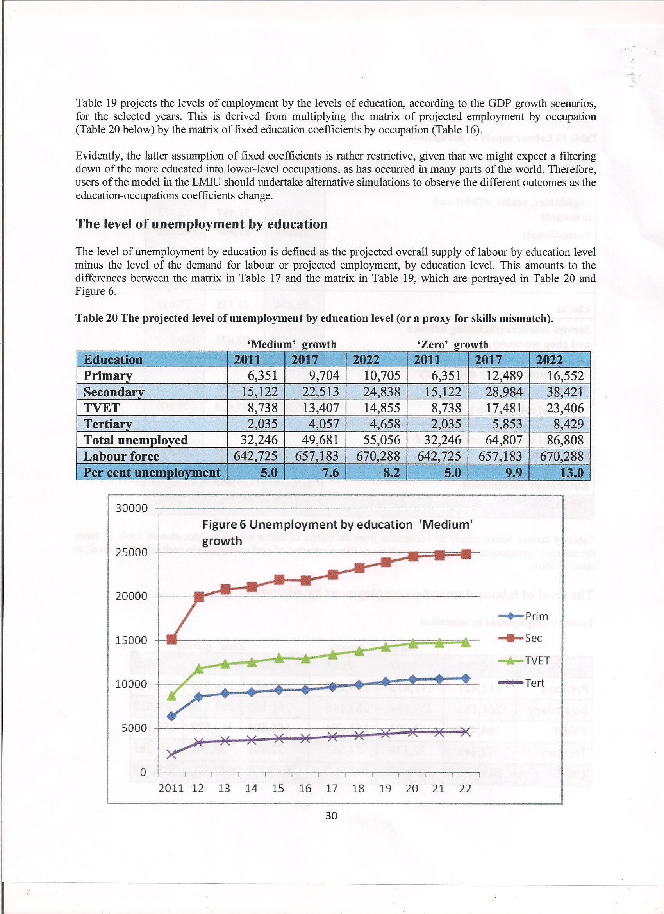

Slide 20
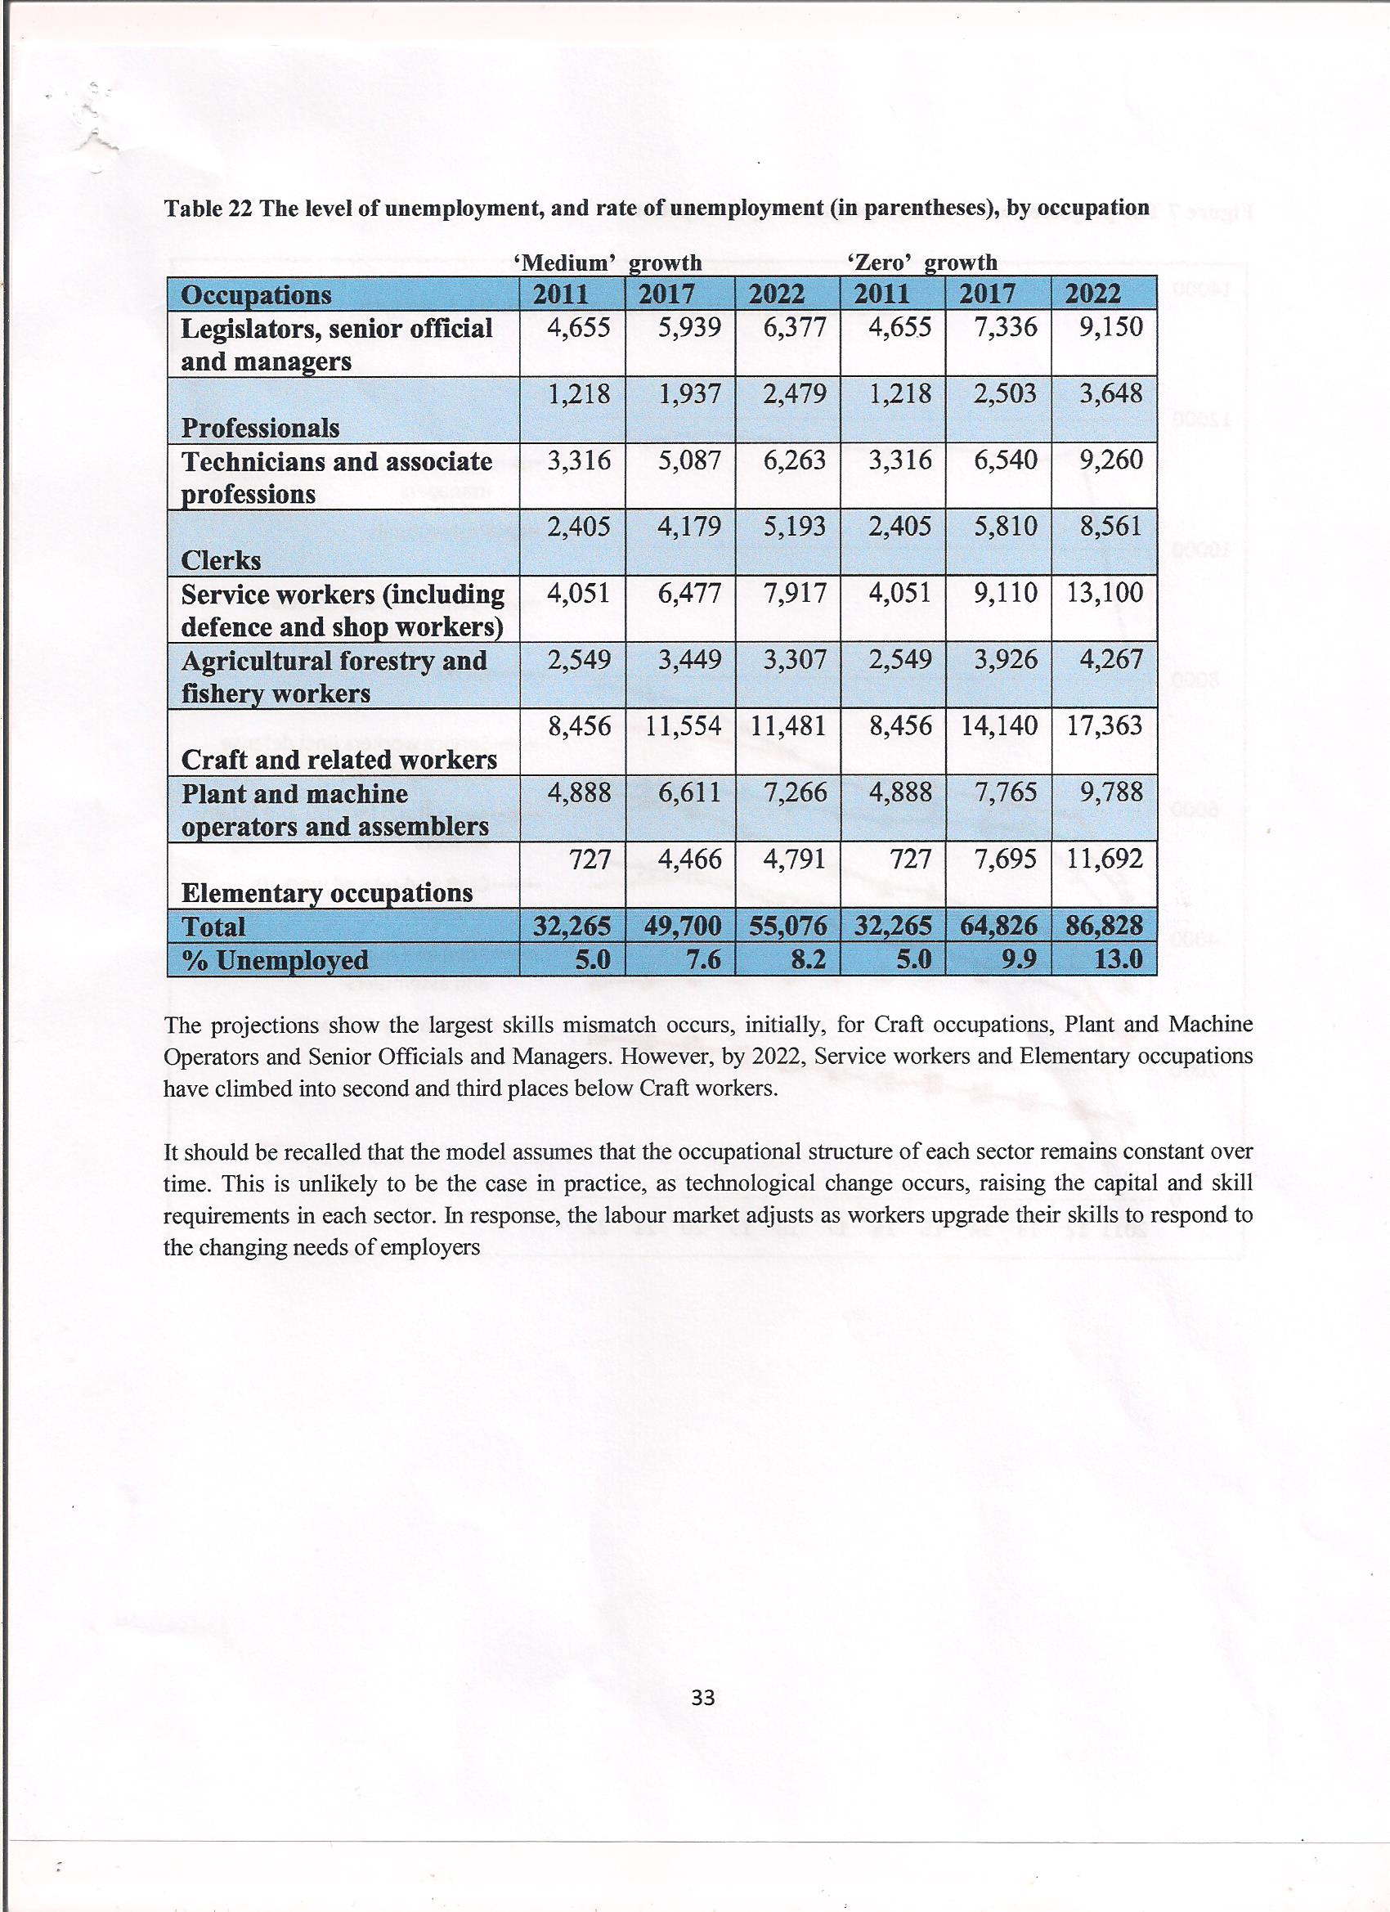

Slide 21
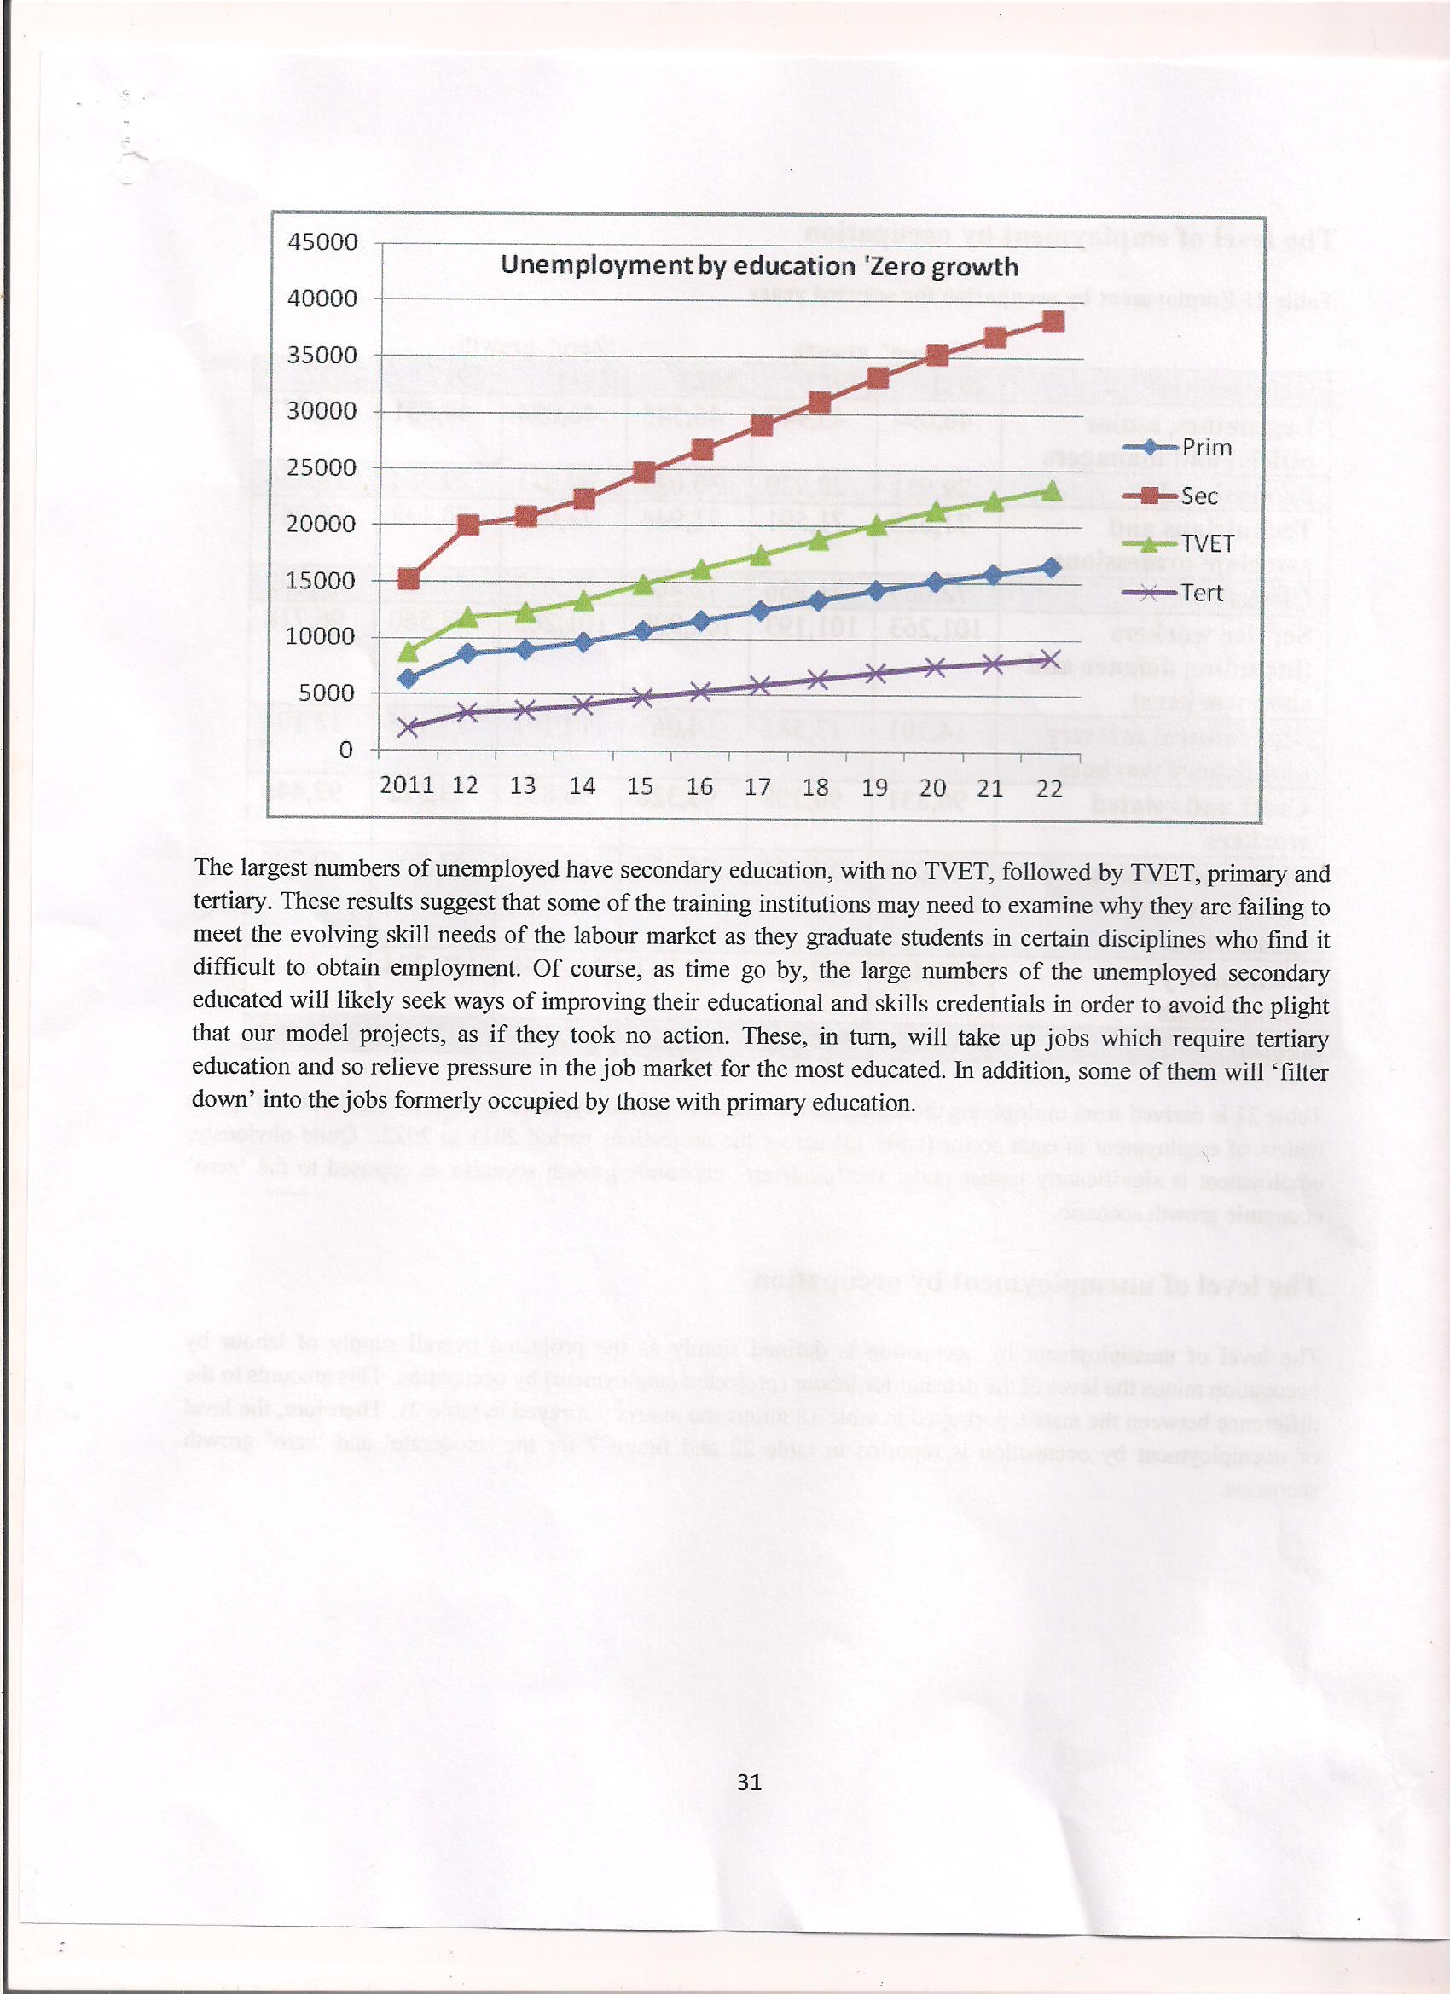

Slide 22
21ST CENTURY DICHOTOMY OR DILEMMA?
Learner control has moved beyond computer assisted programs…

Slide 23
‘THE DICHOTOMY’
“towards authentic learning contexts mediated by technology in which the learner may have a greater control of either tangible or intangible elements of a learning environment”
Aspen Institute:
empower learners to learn any time, any place
support and guide learners in a networked learning environment
interoperability across learning networks

Slide 24
MULTIPLE LEARNING ENVIRONMENTS
Where to now? The learner at the centre of the networked world……..
HE/SHE DICTATES LEARNING PARAMETERS, STYLES, SOURCES AND CONSUMPTION..

Slide 25
DYNAMICS OF THE DICHOTOMY
Planning
Synthesizing
Sharing
Discussing
Reflecting
Giving
Receiving and
Responding to feedback (JISCm 2008, p.6)
‘self-assessment, (self identification)
self-management (personal interest)
Teamwork (collaboration & cooperation)
Lifelong learning (feedback & communication)
Life-wide learning (institutional awareness)
Professional integrity (Caring and Empathy)
Innovative strategies (Ideas Generation)
Creativity (Strategic in intent & Focused) (Cambridge (2008)

Slide 26
THE BENEFITS
Environmental awareness
Entrepreneurial capabilities
Work-space readiness
Productive capacities
Results-oriented approach to life (Cambridge, 2008)
Communication
Technological Competence
Choice & ownership of material…..
COMPETENCIES
ASSOCIATED WITH INDEPENDENT LEARNING

Slide 27
THEMES OF INDEPENDENT – SELF LEARNING – EXPERIENTIAL –PRIOR & SELF DIRECTED LEARNING
THEME 1: CHOICE AND OWNERSHIP:
THEME TWO: FEEDBACK:
THEME THREE: :TECHNOLOGICAL COMPETENCE:
THEME FOUR: SELF IMPROVEMENT AND OWN STRATEGIES:
THEME FIVE: DUAL PERCEPTIONS FOR ACADEMIC MOBILITY:

Slide 28
INDEPENDENT LEARNING MODELS
Recognizes an information Need
Addresses the Information Need
Retrieves Information
Evaluates Information Critically
Adapts Information
Organizes Information
Communicates Information
Reviews the Process
SKILLS & COMPETENCIES OF THE INFORMATION LITERATE PERSON

Slide 29
INDEPENDENT LEARNING MODELS (cont’d)
COMPETENCIES ASSOCIATED WITH THE INDEPENDENT LEARNER
LEARNING ENHANCEMENT
COACHING AND DEVELOPMENT
‘360’ FEEDBACK
PERFORMANCE MANAGEMENT
INTERVIEWING
ORGANIZATIONAL & TEAM EFFECTIVENESS
SUCCESSION PLANNING AND HIGH POTENTIALS

Slide 30
DEFINING THE QUALITY ASSURANCE SYSTEM WITHIN A MODEL
PORTFOLIO DEVELOPMENT & PRESENTATION
THE STUDENT
AS LEARNER
*E-PORTFOLIOS, *EXPERIENTIALEDUCATION *LIFE-LONG LEARNING, *WORKPLACE LEARNING, *INTERNSHIPS
SELF DEV.
&
IMPROVE-MENT
THE STUDENT
C
THE ABOVE MODEL IS PREMISED ON THE OVER-RIDING COMPONENTS OF THE ADMINISTRATION AND THE LEARNING & TEACHING STRATEGIES
CHOICE & OWNERSHIP OF MATERIAL
TECHNICAL COMPETENCE
FEEDBACK
OUTCOME FOR MOBILITY

Slide 31
MAPPING COMPETEN-CIES
INFORMATION
GUIDANCE
FOLLOW-UP
ASSESS-MENTS
COLLABORA-TION AND COORDINA-TION
PRE-CONDITIONS
DOCUMEN-TATION

Slide 32
MAKING THE CASE
It is our hope that a case can be made out or has been made out to engage our administrators, academic providers, RESEARCHERS and students – so that the personalized and independent work of students – prior to, during and as part of continuous education, is given credit for academic mobility, as well as linked to the workplace AND THE PROVISION OF DEMAND-LED EMPLOYMENT……..

Slide 33
CONCLUDING REMARKS
This we hope will create greater opportunities for cross border education & training, ‘on-line education & training, academic competencies, recognition for specific fields of endeavor, and at the same time encourage innovative and new vistas for students, teachers, lecturers, instructors and administrators, employers, and other stakeholders – including the community…..

Slide 34
APPRECIATION!!! ……”Thank you for your attention & participation… comments?? Mervyn Extavour – Director, Accreditation Council of Trinidad & Tobago (ACTT)© President, NATPETT – National Association of Technical Tertiary and Professional Educators of Trinidad & Tobago© - Mervynex@gmail.com Everainbow@tstt.net.tt Extavourme@gmail.com April, 2015© POS, TT©

