Slide 1
Customer Service for Sustainable Tourism in a Post Petroleum-Based Economy
.
Presented by:
Leslie-Anne Samuel Tourism Development and Management – UWI St Augustine

Slide 2
THE PROBLEM
Trinidad and Tobago will become a post petroleum economy in the future, and the country must develop other sustainable sources of income.

Slide 3
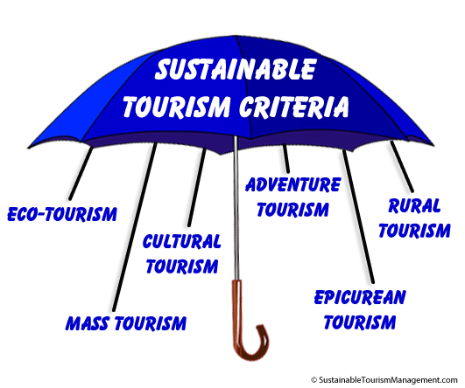
ONE SOLUTION TO THE PROBLEM
Sustainable Tourism

Slide 4
Based on UNEP & UNWTO, Sustainable Tourism is:
Economic
Environmental
Educational
Experiential
Enduring
Encompassing

Slide 5
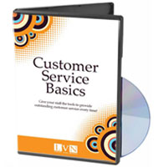
CUSTOMER-SERVICE IN TRINIDAD & TOBAGO
Little research
No academic or published studies
Negative anecdotal information

Slide 6
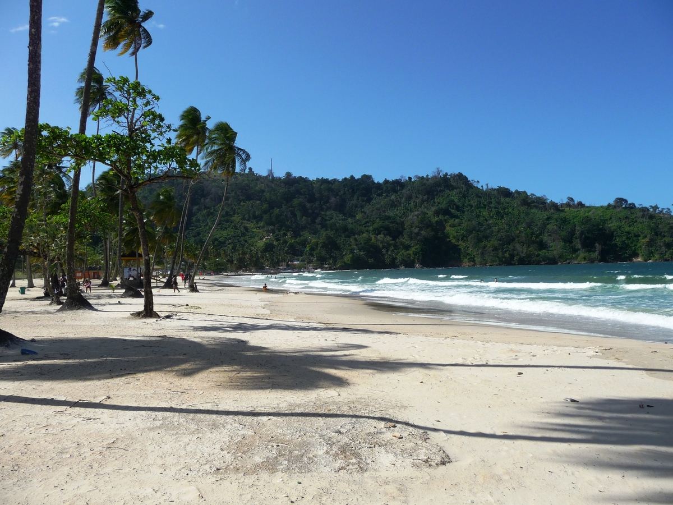
ANECDOTAL EVIDENCE
Trinidad and Tobago was named one of
the 10 least tourist-friendly nations on
Earth - Huffington Post,(2013).
http://www.huffingtonpost.com/2013/03/12/least-tourist-friendly-nations_n_2859061.html

Slide 7
The heart of the tourism industry is good customer service at all levels and in all business areas.
Success in tourism comes from well trained staff offering good customer service
Solimar International
Notes:
The heart of the tourism industry is good customer service at all levels and in all business areas.

Slide 8
REASONS FOR STUDY
To discover employees’ perceptions of customers and customer- service
To add to the limited body of information in the area of customer- service
To contribute to curriculum planning for customer- service training in Trinidad and Tobago

Slide 9
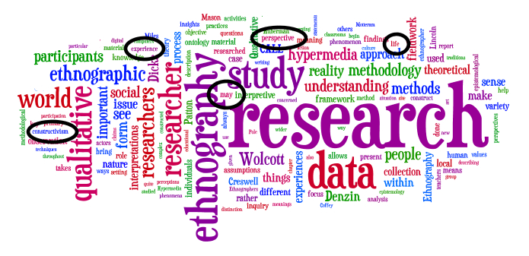
METHODOLOGY
Mixed Methods Research
Literature Review
Pre-test
Field Research
Data Analysis

Slide 10
THE LITERATURE REVIEW
Information from international
studies which answer :
What is service?
Lovelock & Wirtz,(2007);
Schneider & White,(2004)
Who is the customer?
Juran,(1998);
Hallis & Gokgoz,(2007)

Slide 11
THE LITERATURE REVIEW
What is customer service?
Schneider& White (2004);
Gounaris (2008); Cran (1994)
Steinberg & Figgart (1999)
What is service quality?
Parasuraman, Berry & Zeithaml (1995)

Slide 12
The Sample
Two fast-food/quick-service franchises located throughout Trinidad and Tobago.
1) An indigenous Business (The Local)
2) A foreign-origin Entity (The Foreign)
Notes:
Why? Aradbili et al 2011; Rimington &Yuksel (1998)

Slide 13
PRE-TEST
Questionnaire:
Servqual
Surveyshare.com
Kattara, Weheba and El-Said (2008 )
Notes:
Business opened on time
Greeting welcome
Up selling/offering other products.
Acknowledgement

Slide 14
OBSERVATIONS
Neither branch opened on time.
Local franchise branch manager and cook were only employees present at opening. Manager deputized for attendant.
1st customer at the Local was not attended to promptly.

Slide 15
POINTS OF INTEREST
Security Officer at the Foreign responded that customer-service is not her job.
The majority at both the Local and the Foreign, agreed and strongly agreed that it was unrealistic of customers to expect prompt service each time.
A minority of both restaurants agreed and strongly agreed that customers sometimes interrupted their work (Front-house and Counter staff).
All respondents, but one, agreed and strongly agreed that they naturally enjoyed serving and helping others.

Slide 16
RECOMMENDATIONS FOR EDUCATION/TRAINING/CURRICULUM PLANNING.
Compulsory customer-service training with an emotional- intelligence/emotional- regulation component should be provided for all tourism workers.
Internal marketing should be included as a significant component of customer-service training for managers .

Slide 17
Thank you
for your attention.
I welcome your comments, questions or your customer- service experiences!
http://www.trinifans.com/bad-customer-service-trinidad-tobago-t2225.html#.VRzu-fnF8ms

