Slide 1
HOW TVET INSTITUTIONS RESPOND TO CHALLENGES IN COLLECTING LABOUR MARKET INFORMATION
YTEPP Limited 2015

Slide 2
Introduction
YTEPP Limited
Background
Tactical curriculum
Labour Market Information
Data Collection Challenges
Methods and Recommendations
Classifications
Research design

Slide 3
YTEPP LIMITED
Skills Training to population between 15-60 years
Focused on Human Resource Development
Training needs are demand led
Development of curricula based on labour market

Slide 4
Trinidad and Tobago’s 7 areas for development
Film Sector
Food and Beverage Sector
Merchant Marine Sector
Printing and Packaging Sector
Yachting Sector
Seafood Sector
Music and Entertainment Sector

Slide 5
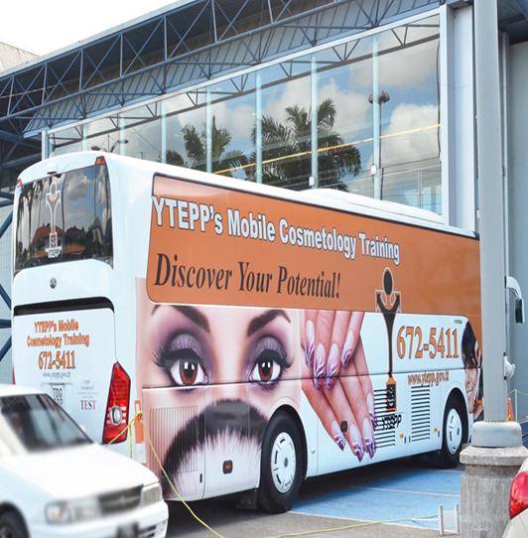
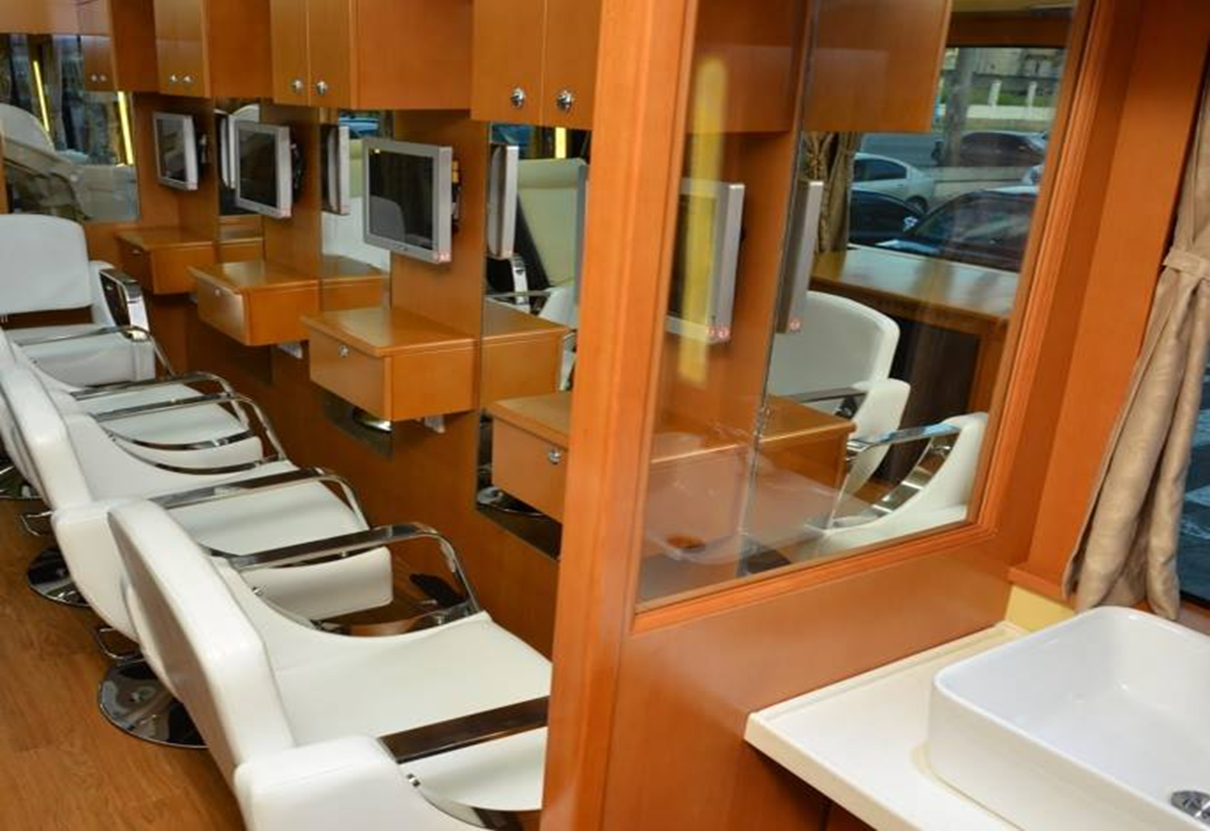
Film, Music and Entertainment Sector – Cosmetology

Slide 6
Seafood Sector – Tilapia production

Slide 7
YTEPP Limited New Training Partnerships and Alliances
YTEPP Limited and Metal X Engineering Limited
Mimics an On-the-Job training arrangement
18 graduates trained over 2 years
Half employed by Metal X upon completion
YTEPP’s Refrigeration and Air Conditioning Apprenticeship Programme

Slide 8
Labour Market Information and Its Importance
LMI helps identify trends and anticipate industry needs
Streamlining outputs of training programmes to serve industry needs
Partnerships between private and public entities
Stimulus for growth – demand driven workforce
Assists TVET sector in fulfilling growing demand needs of a country

Slide 9
Labour Market Information and Its Importance
Tracer study (2007-2011 graduates) by YTEPP Limited identified
Only 52% graduates found employment
Significant number not able to find employment in trained area
Although research is dated it reflects circumstances - challenges in sourcing employment in field of training

Slide 10
LMI Planning Experience
C-EFE Programme Project – Partnership with Vancouver Island University
Centre of Excellence for Cosmetology
Labour Market study for Cosmetology sector

Slide 11
Challenges in collection of Labour Market Information
Relevance and classification of information
Availability of information
Accuracy and inadequacy of information
The timeliness with which output is disseminated
Lack of technology

Slide 12
Methodology
Development of baseline data
Just in Time method
Collecting data using employer published vacancies
Mixed Method approach
Making use of new technology

Slide 13
Recommendations
Utilizing Ministry of Education’s National Occupation Classification of Trinidad and Tobago
Conducting skills demand research
Continuously updating data using Just in Time
Sector Advisory Councils
Utilize available enhancements in technology
Host and participate in industry consultations

Slide 14
Conclusion
The utilization of varying methodologies to develop accurate data
Develop Baseline data
Just in Time approach
Mixed Method
Collaboration between various government agencies in collection of labour market information
Conduct skills demand research

Slide 15
Thank you

