Slide 1
Bridging the gap: Industry needs vs. educational reality in Jamaica
Presented by: Yolanda Henry
ACTT Conference 2015
Port of Spain, Trinidad and Tobago

Slide 2
Context of research
High unemployment rate in Jamaica
Constantly changing industry needs
Employers’ difficulty in finding suitable candidates for available jobs
Community college offerings vs. demand/needs of job market
Need for students to be more discriminating consumers
Deficiencies in tertiary education

Slide 3
Purpose of research
This study was undertaken with the intention of comparing the extent to which the programmes being offered in community colleges reflect the needs/demands of the Jamaican job market.

Slide 4
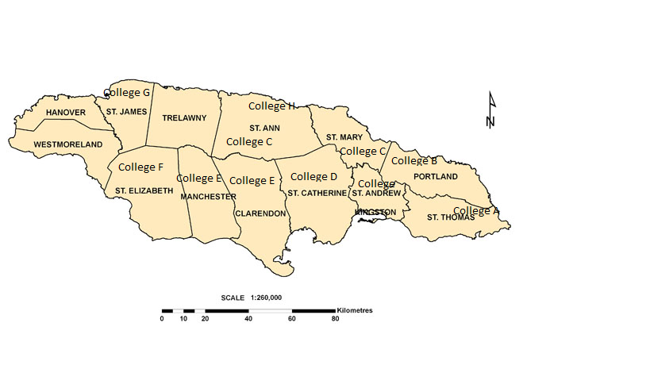
Map showing Location of Community Colleges in Jamaica

Slide 5
Research questions
The research was guided by the following research questions.
What are the jobs that are in greatest demand within the Jamaica labour market?
To what extent do programme offered in community colleges reflect industry demands/needs?
What methods are employed by community colleges to test students’ readiness for the job market?

Slide 6
Methodology
Qualitative – exploratory
Primary and secondary sources
Primary Sources
Interviews conducted with lecturers and industry personnel
Secondary Sources
Industry reports, e.g., the Jamaica Labour Market Survey (JLMS) which is commissioned by the Ministry of Labour and published by HEART (Human Employment and Resource Training) provided information re jobs in demand
Council of Community College (CCCJ) statistics and programme offerings brochures

Slide 7
Literature review
Job readiness – what does it mean?
skill sets that make graduates and other individuals adaptable to a given work environment (ACT, 2013)
Employability skills demanded by employers
Encompasses cognitive (technical) and non-cognitive (soft skills) (Conference Board of Canada).
On the job training
Skills required on the job versus skills acquired in the classroom

Slide 8
Literature review
Which is more important - college degree or work experience?
Depends on who you ask
Sadly, much of the literature in this area originates from North America. While it might be applicable, it cannot speak specifically to our context since there are many different variables that are unique to the Caribbean.

Slide 9
Findings

Slide 10
Demands in the jamaican job market
Skills/Occupational Areas in Demand in the Jamaica Labour Market in 2014

Slide 11
Student enrolment in programmes for Year 2014/2015 at one community college

Slide 12
Demands vs. Programme offerings
The difference/disconnect between demands of job market and college programmes is not as great as is generally perceived

Slide 13
Demands vs. Programme offerings
Ranking | Jobs | Programmes of Study
1st | Services | Tourism
2nd | Agriculture | Business & Entrepreneurship
3rd | Tourism | Liberal Arts
4th | ICT | Engineering and Built Environment
5th | Creative | Natural Sciences
6th | Manufacturing | Computer
7th | construction | Performing Arts
8th | Health | Library Studies
9th | Education

Slide 14
Findings
Major challenges in students’ preparation include:
Outdated or “watered down” syllabi
Shortness of time to complete syllabi - students have to be prepared to work in ‘pressure cookers’
Non- alignment of course outlines to what is happening in the world of work
Lack of basic readiness among graduates
Students’ mediocrity – ‘okay with being ok’
Financial constraints faced by some colleges
Rapidly and ever changing work environment

Slide 15
Major weaknesses of students
Inability to think logically
Inability to think outside of the box
Inability to problem solve
Lack of persistence
Inability to integrate knowledge – for example, students find it difficult to transfer concepts linking Computerized Accounting and Mathematics
Lack of professionalism

Slide 16
Major weaknesses of students
Lack of initiative
Lack of motivation – greatest motivation seems to be money but students are not willing to invest enough time and effort to acquire it
Lack soft skills – don’t know how to relate to each other – problems with attitude, body language, speech, and gestures

Slide 17
Students’ strengths
Willingness to learn and try new things
openness to discovery learning
Being trainable - adapt to changes quickly
Flexibility
Exposure to and expertise with regard to technology

Slide 18
Strategies to improve student readiness
Lecturers’ need more exposure to the workforce
Reduce reliance on past papers and theoretical exam questions – increase industry tasks
Insistence on the things required in the work environment, for example, dress codes and use of Standard English.
More intense work experience and social outreach
Creation of work environment in the classroom

Slide 19
Strategies to improve student readiness
More internship, work experience or field work –ensure that on the job training relate to student’s area of specialization
Apprenticeship – learn in the environment
Enhanced professionalism
Extend delivery time for some courses

Slide 20
Strategies to improve student readiness
Develop competency standards in programme and let areas of specialization be assessed based on competency standard rather than a general exam, then decide whether dual certification should be given – example of competency standards developed by the HEART Trust/NTA were mentioned

Slide 21
Skills sought by employers
Training in required area
Time management skills
Ability to listen well
Being customer oriented
Good interpersonal/people skills
Creativity
Commitment
flexibility
willingness to learn and take on new challenges
analytical thinking

Slide 22
Conclusion
Dichotomy between the demands/needs of the job market and the programmes offered by tertiary institutions is not as great as is often perceived.
Many challenges affect the readiness of graduates for the world of work.
The job market will continue to change and expand and community colleges must change with it if they are to remain relevant.

Slide 23
Recommendations
More engagement with industry - Industry persons need to more actively engaged in curricula development, specifically as it relates to content and delivery
Revamping of some of the current programmes that do not present future prospects for jobs and align them with areas of future and present demand

Slide 24
Recommendations
Career guidance and counselling
More frequent review of curricula to make adjustments for changing industry trends
Transform classrooms into work settings
Mentorship, increased work experience and social outreach/volunteerism

Slide 25
Questions/comments

Slide 26
REferences
ACT. (2013). Work readiness standards and benchmark: The Key to Differentiating America’s Workforce and Regaining Global Competitiveness retrieved from http://www.act.org/research/policymakers/pdf/ Work- Readiness-Standards-and- Benchmarks.pdf
Adamson, Cebert. (2012, February 12). The role of Jamaican community colleges in economic recovery. The Sunday Gleaner retrieved from .jamaica-gleaner.com/gleaner/20120212/ business/business72.php
Chen, Grace. (n.d.). Benefits of internship for community college students. Community College Review

Slide 27
REferences
Conference Board of Canada. (n.d.). Employability skills 2000+ retrieved from ww.conferenceboard.ca/Libraries/ EDUC_PUBLIC/esp2000.sflb
Council of Community Colleges of Jamaica (CCCJ). (2013). Student handbook: Associate and bachelors of science degree in business studies. Kingston: CCCJ
Council of Community Colleges of Jamaica (CCCJ). (2014). Programme Brochure: Kingston. CCCJ

Slide 28
REferences
Ferris State University. (n.d.). Internship Benefits For students retrieved from http://www.ferris.edu/business/internsh ip-benefits)
Fischer, K. (2013). The employment mismatch. Chronicle of Higher Education
Ha, John (n.d.) Education vs. experience: The debate. retrieved from http://www.reliable plant.com/Read/11307/education-vs- experience)
HEART Trust. (2014). Labour market survey. Kingston: HEART Trust

Slide 29
REferences
Leong, R. & Kavanagh, M. (2013). A work integrated learning (WIL) framework to develop graduate skills and attributes in an Australian university’s accounting program. Asia pacific journal of Cooperative Education, 14(1), 1-14
Lowden, K., Hall, S., & Lewin J. (2011). Employees’ perception of the employability skills of new graduates: SCRE Centre and Edge Foundation. University of Glasgow
Noteboom, Ben. (2013). Making labour market inclusive retrieved from http://www.oecd.org/ employment/making-labour-markets- inclusive.htm

Slide 30
REferences
OECD. (2012). OECD 2012 report -Into the gap: exploring skills and mismatches retrieved from http://www.oecd.org/employment/into-the gap- exploring-skills-and-mismatches.htm
Robbins, S. P., & Judge, T. A. (2011). Organizational behaviour (14th ed.). NJ: Prentice Hall.

Slide 31
REferences
Smith-Henry, D.V. (2011). Perceived readiness of Jamaica community college students for post college goals (Doctoral dissertation). University of Georgia
World Economic Forum. (2015). Global Competiveness Index Report (GCI) 2014-2015 retrieved from www.weforum.org/ reports /global-competitiveness-report-2014- 2015

